Slide 1
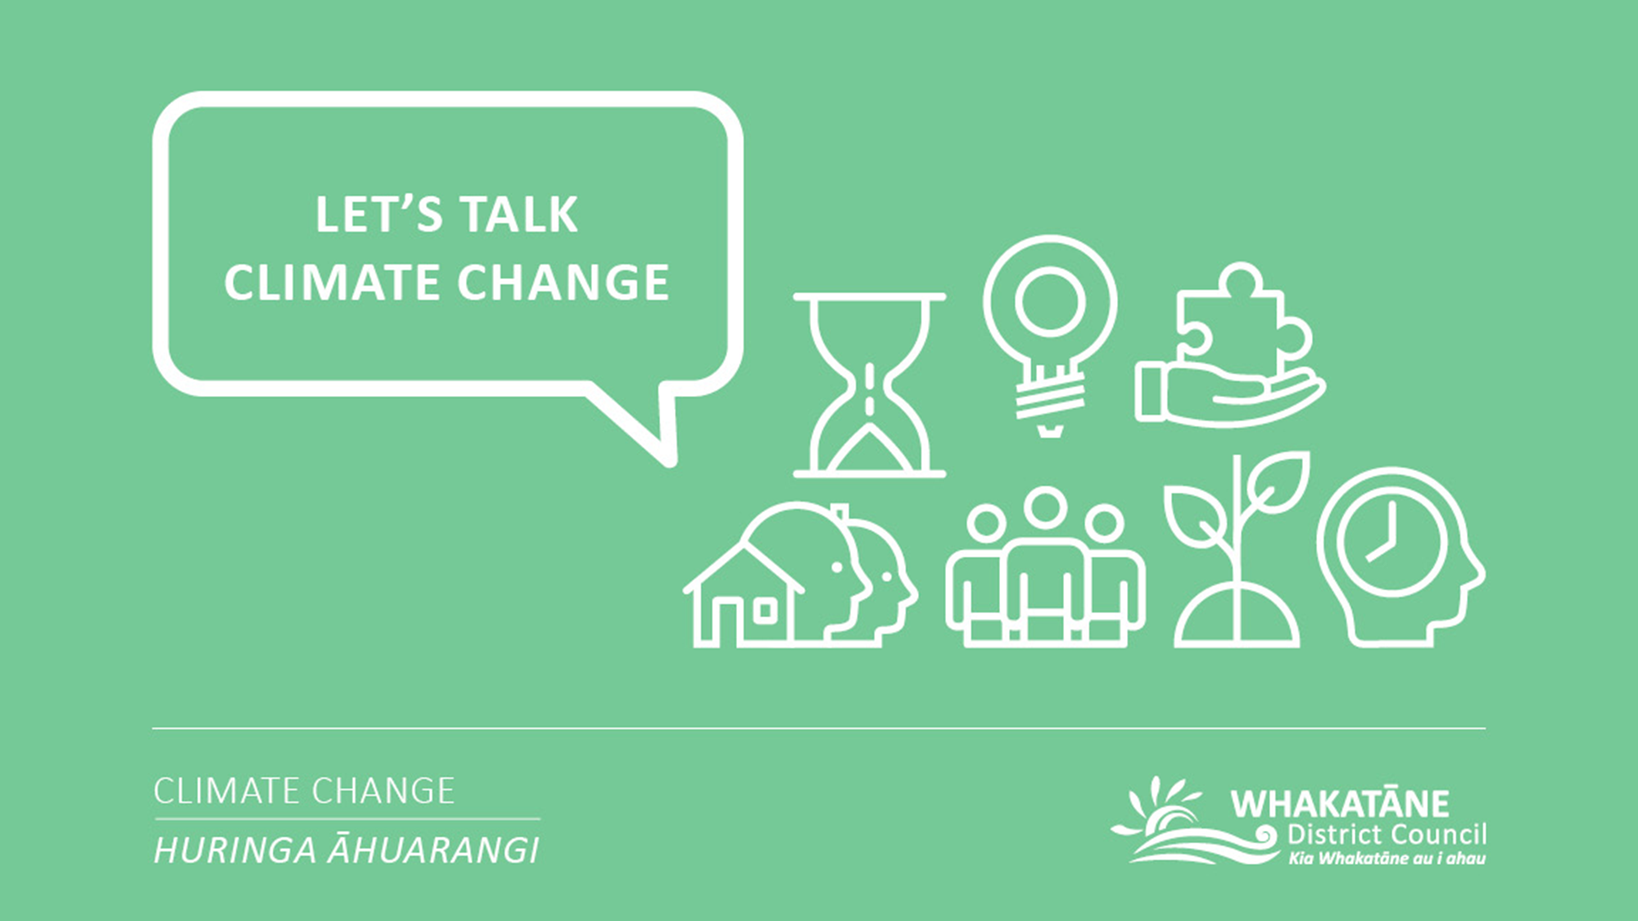
E-LEARNING

Slide 2

Whakatauki
Ko Papatūānuku te matua o te tangata
Papatūānuku is the parent of the human race

Slide 3
Disclaimer:​
The information included in this e-learning hub has been compiled by the Whakatāne District Council to help us and our community on a journey of learning and development. The Council does not own and is not the authors of most of the content included in this hub. The Council has compiled content that we felt to be relevant, engaging and wherever possible to provide a local context. Further information regarding Council’s Climate Change Principles, our Climate Change project or our current engagement opportunities can we found on our project page:​
https://www.whakatane.govt.nz/climate-change

Slide 4
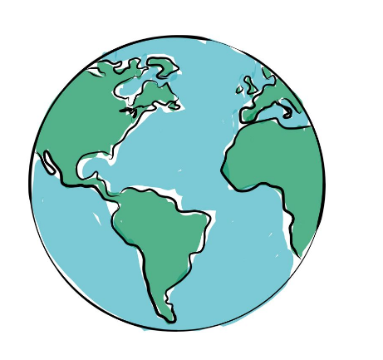
Module 1: Climate change 101
Topics covered in this module:
Climate change 101
  1.1. Mitigation and adaptation
International context
2.1. The United Nations Framework Convention on Climate Change (UNFCCC)
2.2. The Paris Agreement
National context
3.1. Legislative context
3.2. Where is New Zealand at?
3.3. The New Zealand Local Government Leader’s Climate Change Declaration
4. Likely impacts of climate change
4.1. Likely impacts of climate change in New Zealand
4.2. Likely impacts of climate change in the Bay of Plenty
5. Wellbeing and climate change
6. The impact of climate change on biodiversity and ecology
    6.1. The impact of climate change on the biodiversity and ecology of New Zealand
Learning statement for this module
What is climate change and how is it going to impact us?
Followed by a short survey to reflect on your comfort levels with the concepts covered in this Module.

Slide 5
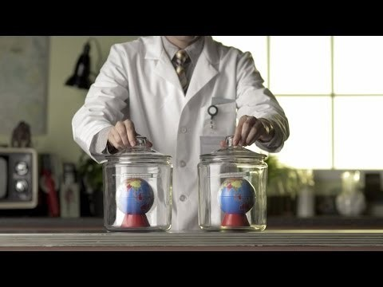


1. Climate change 101
What is climate change?
What causes it?
What’s the science?
5min
https://www.youtube.com/watch?v=3v-w8Cyfoq8 (15/04/2020)

Slide 6
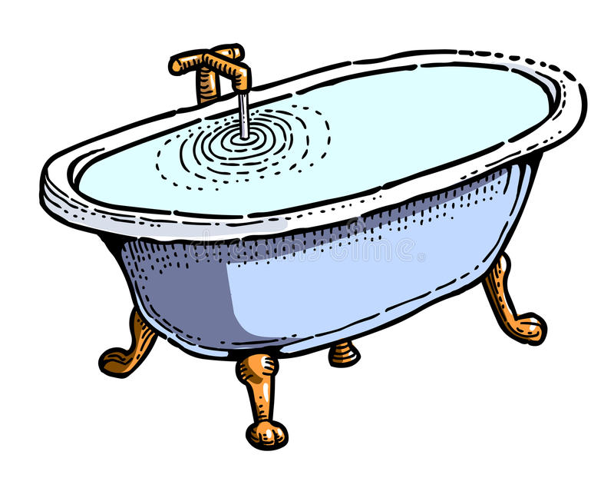

1.1. Mitigation and adaptation
In New Zealand we talk quite specifically about Climate Change ‘Mitigation’ and ‘Adaptation’:
Mitigation is about reducing the amount of change to our climate in the future by reducing green-house gas emissions now.
Adaptation is about how we respond to the impact of a changing climate (such as sea level rise, changes in temperature, rainfall etc.)
Using a bathtub analogy, green-house gas emissions are like the water that comes out of a tap. Turning the tap up or down emits more or less water. Mitigation is like turning the tap down or off.
Imagine realising you left the bathtub water running and now the bath is overflowing.
The first thing you want to do is stop more water making the situation worse, so you turn the tap off.
Using the same bathtub analogy, adaptation is how you respond to the water that has already over-flowed.
Damage has already happened and more will continue into the future unless we undertake actions to deal with the water. There’s water on the floor and it is now running down the hallway… You have no choice than to clean up the best you can to stop the water causing further damage.

Slide 7
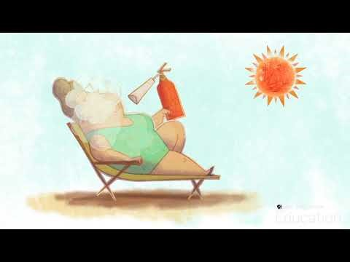
More on mitigation and adaptation:
3min
https://www.youtube.com/watch?v=fmBDZKOdbkY (28/05/2020)

Slide 8

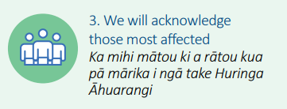
2. International context
2.1. The United Nations Framework Convention on Climate Change (UNFCCC)
The United Nations Framework Convention on Climate Change (UNFCCC) is an international environmental treaty with the objective to:
“Stabilize greenhouse gas concentrations in the atmosphere at a level that would prevent dangerous anthropogenic interference with the climate system”.
The UNFCCC was adopted by over 185 countries including New Zealand at the Rio Earth Summit in 1992.
The Kyoto protocol in 1997 is an international treaty that extends the 1992 UNFCCC and commits state parties to reduce greenhouse gas emissions, based on the scientific consensus that:
Global warming is occurring
It’s extremely likely that human emitted CO2 emissions have predominantly caused it.
Whakatāne District Council
Acknowledges that mitigating and adapting to climate change is the right thing to do not only for people but also for the health of the planet
Learn more: https://unfccc.int/

Slide 9
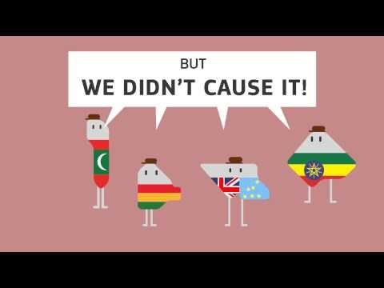
The history of climate change negotiations in 82 seconds:
1min
https://youtu.be/B11kASPfYxY (22/05/2020)

Slide 10
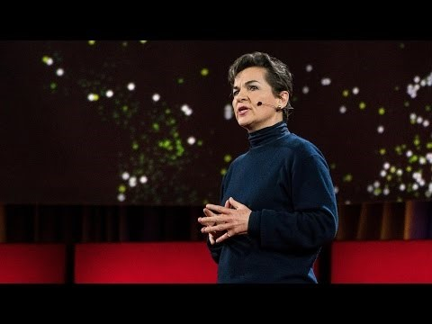
2.2. The Paris Agreement
The Paris Agreement is an agreement within the United Nations Framework on Climate Change (UNFCCC) signed in Paris 2016.
The Paris Agreement’s central aim is to strengthen the global response to the threat of climate change by keeping a global temperature rise this century well below 2 degrees Celsius above pre-industrial level and to pursue efforts to limit the temperature increase even further to 1.5 degrees Celsius.
https://youtu.be/MIA_1xQc7x8 (21/04/2020)
15min
More on the Paris agreement on the UN homepage:
https://unfccc.int/process-and-meetings/the-paris-agreement/the-paris-agreement

Slide 11
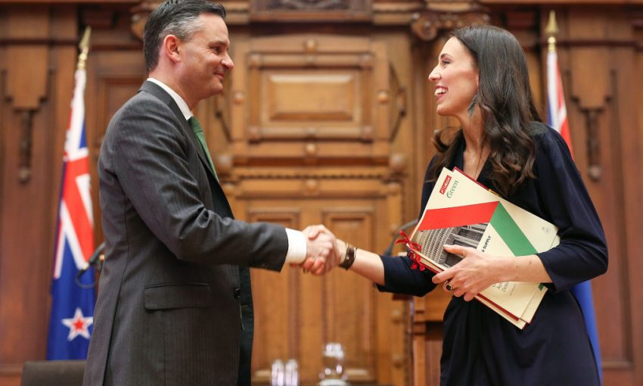
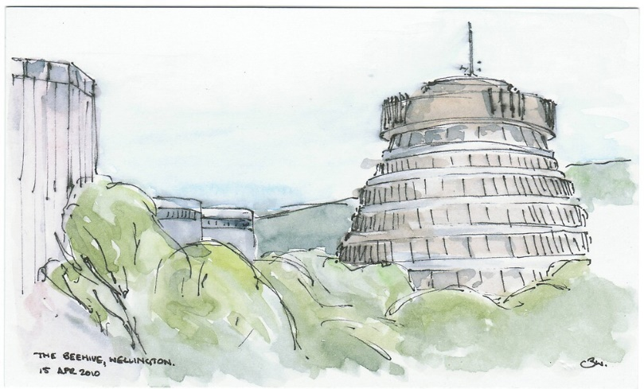

3.1. Legislative context
3. National context
There are three key pieces of legislation that specifically guide New Zealand’s response to climate change:
The Climate Change Response Act 2002,
The Climate Change Response (Zero Carbon) Amendment Act (2019),
The Resource Management Act 1991 (RMA).
These are summarised on the following slides.

Slide 12
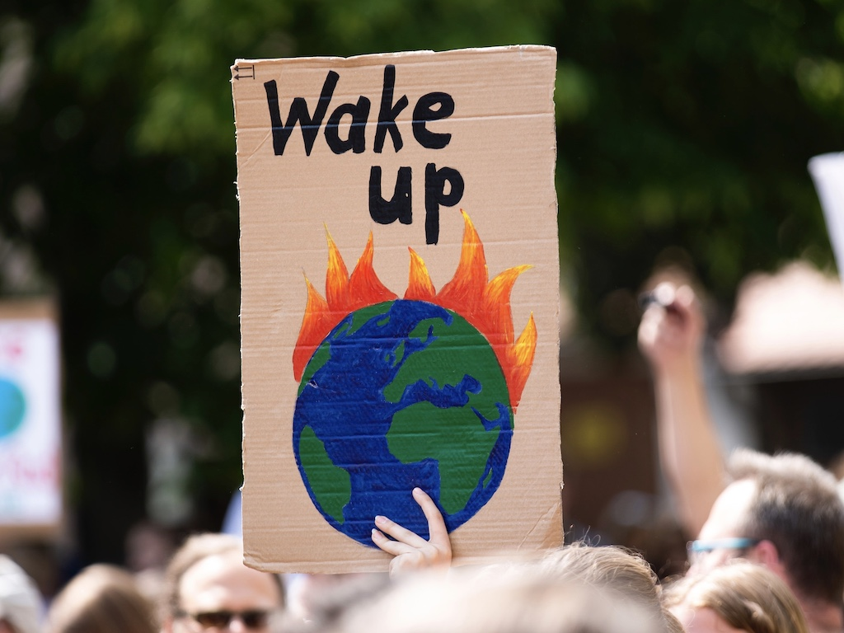

1. Climate Change Response Act 2002
The Climate Change Response Act 2002 puts in place a legal framework to enable New Zealand to meet its international obligations under the United Nations Framework Convention on Climate Change and the Kyoto Protocol.
The Act includes powers for the Minister of Finance to manage New Zealand’s holdings of units that represent New Zealand’s target allocation for greenhouse gas emissions under the Protocol.
It enables the Minister to trade those units on the international market.
It establishes a registry to record holdings and transfers of units.
The Act also establishes a national inventory agency to record and report information relating to greenhouse gas emissions in accordance with international requirements.
The full Climate Change Response Act 2002 (407pages):
http://www.legislation.govt.nz/act/public/2002/0040/latest/DLM158584.html

Slide 13
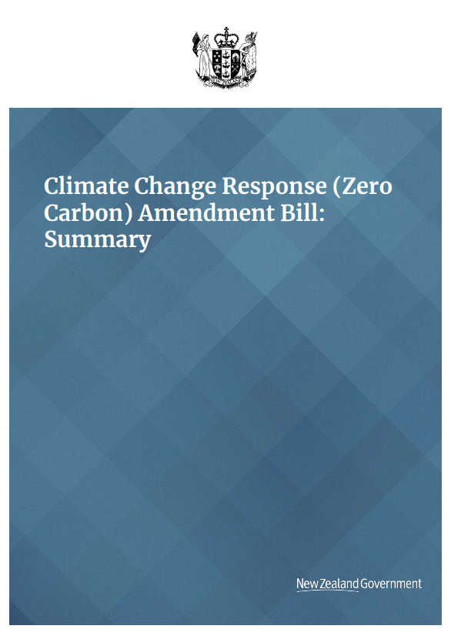



2. Climate Change Response (Zero Carbon) Amendment Act 2019
The Climate Change Response (Zero Carbon) Amendment Act 2019 is an update to the Climate Change Response Act 2002 to enable New Zealand to develop and implement climate change policies in support of the Paris Agreement.
These updates achieve four key things:
1. Set a new domestic greenhouse gas emissions reduction target for New Zealand to:
  Reduce net emissions of all greenhouse gases (except biogenic methane) to zero by 2050
  Reduce emissions of biogenic methane to 24–47 per cent below 2017 levels by 2050, including to 10 per cent below 2017 levels by 2030
2. Establish a system of emissions budgets to act as stepping stones towards the long-term target
3. Require the Government to develop and implement policies for climate change adaptation and mitigation
4. Establish a new, independent Climate Change Commission to provide expert advice and monitoring to help keep successive governments on track to meeting long-term goals.
“Will work with central government to deliver on national emission reduction targets and support resilience in our communities.”
The full Climate Change Response (Zero Carbon) Amendment Act 2019 http://www.legislation.govt.nz/act/public/2019/0061/latest/LMS183736.html
Summary version (17 pages): https://www.mfe.govt.nz/sites/default/files/media/Climate%20Change/climate-change-response-zero-carbon-amendment-bill-summary.pdf

Slide 14
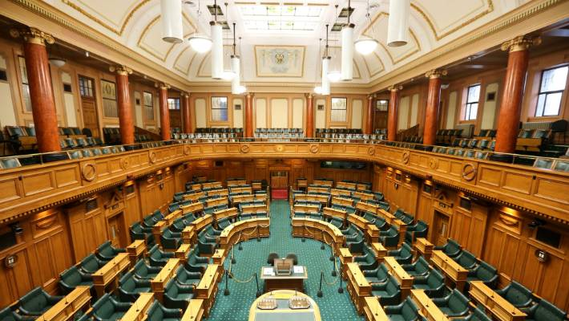
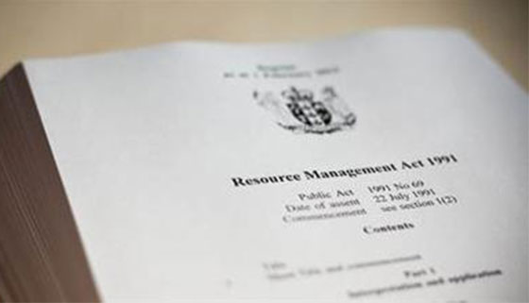

3. The Resource Management Act 1991 (RMA)
Under the RMA, local government is required to consider the effects of a changing climate on communities, and to incorporate climate change into existing frameworks, plans, projects and standard decision-making procedures.
The RMA is a key guiding document for how the Council considers climate change.
The full Resource Management Act 1991:
http://www.legislation.govt.nz/act/public/1991/0069/latest/DLM230265.html

Slide 15


3.2. Where is New Zealand at?
New Zealand participates in international climate change negotiations under the United Nations Framework Convention on Climate Change (UNFCCC), its Kyoto Protocol, and the Paris Agreement.
New Zealand routinely submits to the UNFCCC Secretariat its views on substantive and technical aspects of the climate change negotiations under the UNFCCC.
See submissions:
https://unfccc.int/process-and-meetings/parties-non-party-stakeholders/parties/archive-of-party-submissions
Hon James Shaw is the Climate Change Minister. He has direct responsibility for the overall climate change policy direction for New Zealand at the domestic and international level. This includes representing New Zealand in international negotiations on climate change.
New Zealand’s international climate change policy is developed collaboratively by the:
Ministry of Foreign Affairs and Trade
Ministry for the Environment
Department of Prime Minister and Cabinet
The Treasury
Ministry for Primary Industries
Ministry of Transport
Ministry of Business, Innovation and Employment.
Climate Change Minister
Hon James Shaw
More on New Zealand’s role:
https://www.mfe.govt.nz/climate-change/why-climate-change-matters/global-response/new-zealands-role

Slide 16
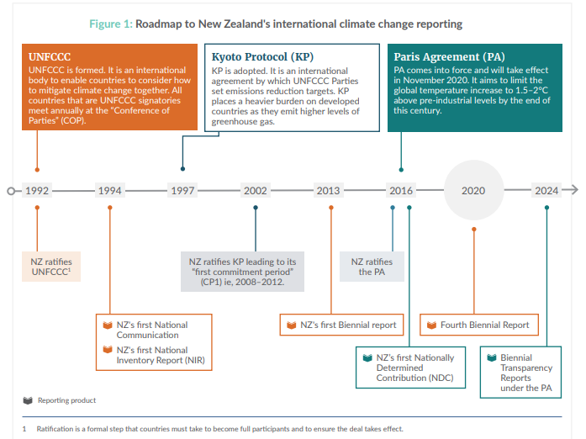
As a party to the United Nations Framework Convention on Climate Change (UNFCCC) and the Kyoto Protocol, New Zealand has mandatory reporting requirements in:
New Zealand’s National Communication
Biennial Reports
These reports make interesting reads and can be found here:
https://www.mfe.govt.nz/climate-change/climate-change-and-government/international-climate-change-commitments
https://www.mfe.govt.nz/sites/default/files/media/Climate%20Change/snapshot-4th-biennial-report-2019.pdf (25/05/2020)
For more information, visit the Ministry for the Environment's webpage:
https://www.mfe.govt.nz/climate-change/climate-change-and-government/international-climate-change-commitments

Slide 17
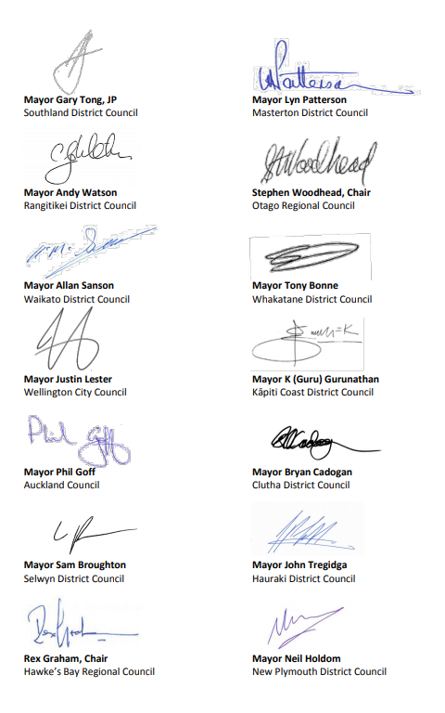
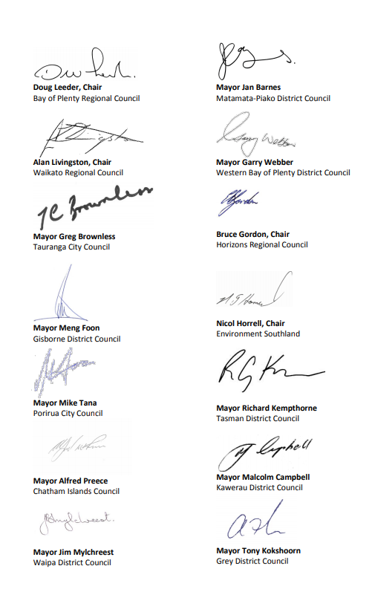

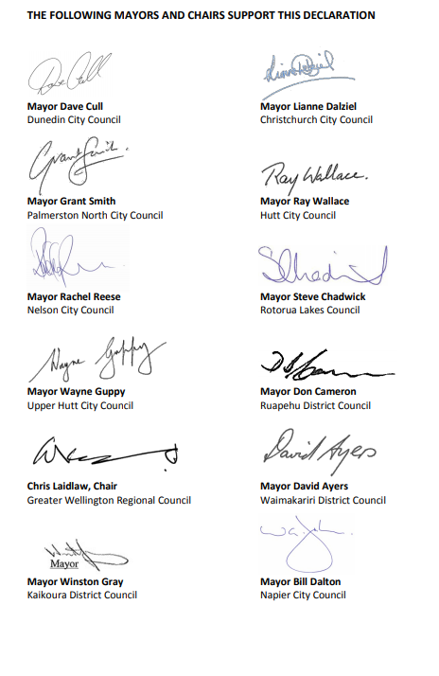

3.3. The NZ Local Government Leaders Climate Change Declaration in 2017
In 2015, Mayors and Chairs of New Zealand declared an urgent need for responsive leadership and a holistic approach to climate change.
In 2017, the Local Government Leader’s Climate Change Declaration was developed, supporting that call to action.
Whakatāne District Council has signed this declaration together with 65 other Councils and Local Authorities.
https://www.lgnz.co.nz/assets/Uploads/0827d40e5d/Climate-Change-Declaration.pdf (21/04/2020)
The full NZ Local Government Leader’s CC Declaration can be found here:
https://www.lgnz.co.nz/assets/Uploads/0827d40e5d/Climate-Change-Declaration.pdf

Slide 18
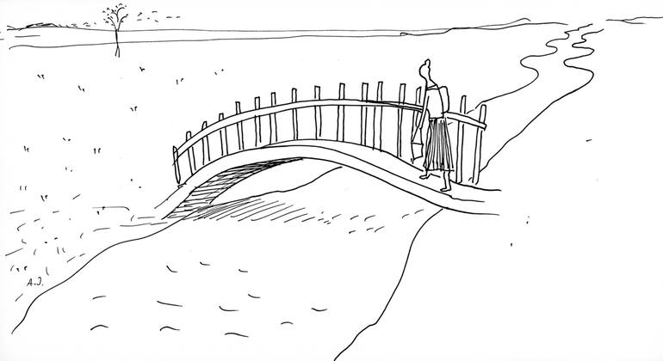
The role and responsibilities of local government and
Council’s climate change project are further covered in Module 3

Slide 19
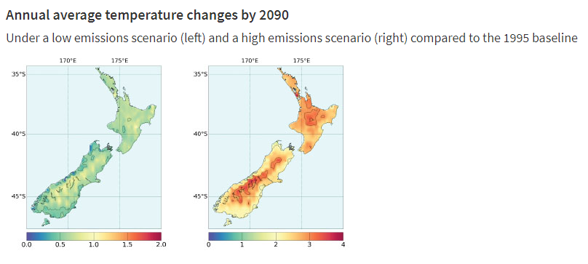
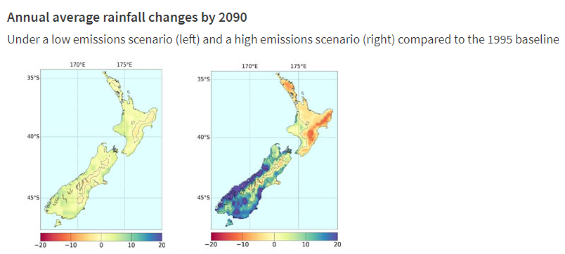
4. The likely impacts of climate change
4.1. The likely impacts of climate change in New Zealand
Our changing climate will affect our economy, environment and way of life.
Based on the latest climate projections for New Zealand, by the end of this century we are likely to experience:
higher temperatures
  greater increases in the North Island than the South, with the greatest warming in the northeast,
  the amount of warming in New Zealand is likely to be lower than the global average
rising sea levels
more frequent extreme weather events
  droughts (especially in the east of New Zealand)
  floods
a change in rainfall patterns
  increased summer rainfall in the north and east of the North Island
  increased winter rainfall in many parts of the South Island.
Likely climate change impacts in New Zealand
https://www.mfe.govt.nz/climate-change/likely-impacts-of-climate-change/likely-climate-change-impacts-nz

Slide 20
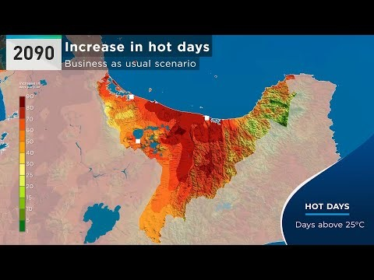
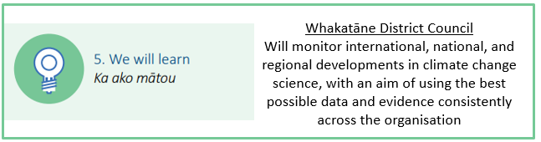
4.2. The likely impact of climate change in the Bay of Plenty
What sort of implications will climate change have on the Bay of Plenty?
What will climate change look like in the Whakatāne District?
These are scenarios and models only, however, they provide us with an estimate of what is to come.
https://youtu.be/JoySrxGtfig (21/04/2020)
4min
For the full ‘Climate change projections and impacts for the Bay of Plenty Region’ report (2019), please click here.

Slide 21
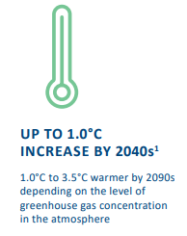
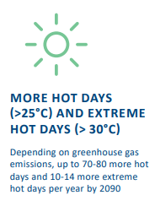
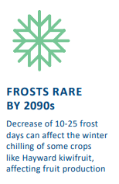
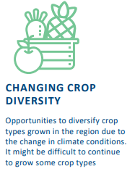
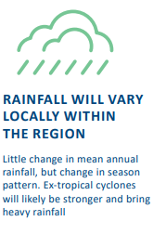
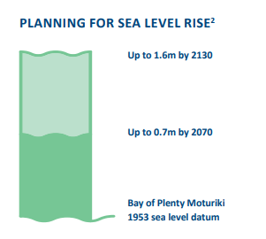
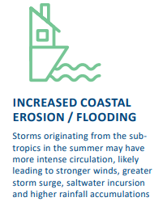
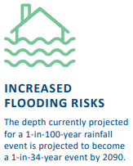
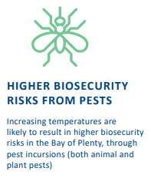
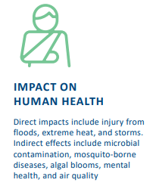
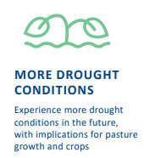
For the full ‘Climate change projections and impacts for the Bay of Plenty Region’ report (2019), please click here.

Slide 22
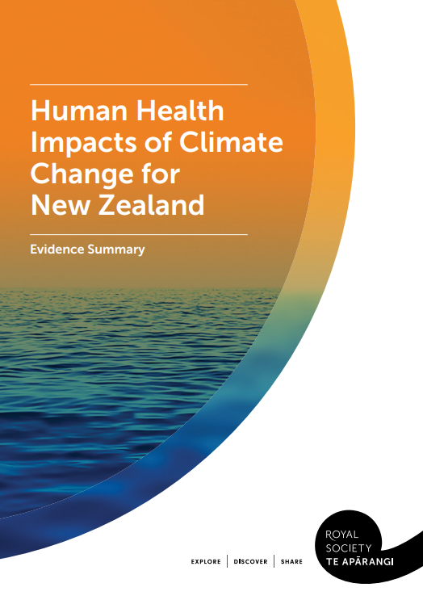
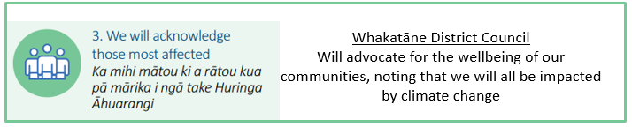
5. Wellbeing and climate change
“Many factors that contribute to our health and well-being as New Zealanders are threatened by climate change. These include direct effects such as increased exposure to heat waves and weather events but also indirect effects, such as reduced water safety or challenges to our mental health”
For the summary report by the Royal Society on Human Health Impacts of Climate Change for New Zealand visit:
https://www.royalsociety.org.nz/assets/documents/Report-Human-Health-Impacts-of-Climate-Change-for-New-Zealand-Oct-2017.pdf

Slide 23

5.1. How climate change will disrupt many factors that contribute to our health
4min
https://vimeo.com/242646268 (29/05/2020)

Slide 24
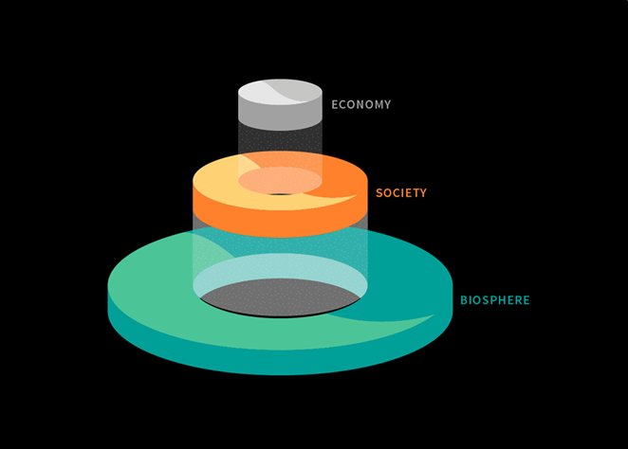
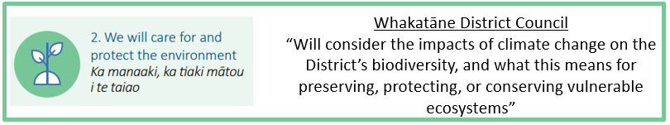
Next we will look at the impact of climate change on the biosphere
The biosphere is the thin layer surrounding our planet that supports all life on Earth. The biosphere is home to societies, in which our economies are embedded.
In Module 2 we will more closely examine the effect of climate change on our societies and our economies.

Slide 25
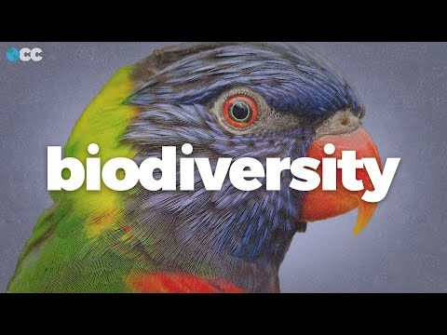
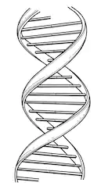
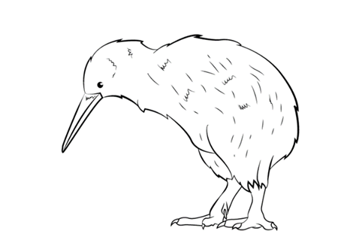
6. The impact of climate change on biodiversity and ecology
Biodiversity is often defined as the variety of all forms of life, from genes to species, through to the broad scale of ecosystems
8min
https://www.youtube.com/watch?v=1cvMX82iwRM (04.04.2020)

Slide 26
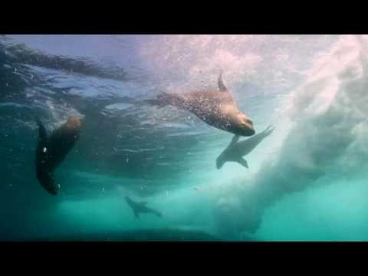
David Attenborough on the importance of biodiversity – “How to save our planet”
8min
https://www.youtube.com/watch?v=0Puv0Pss33M (17.11.2020)

Slide 27
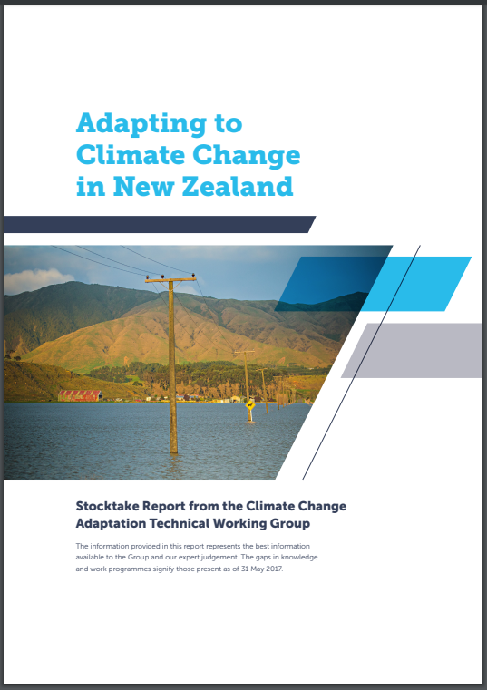

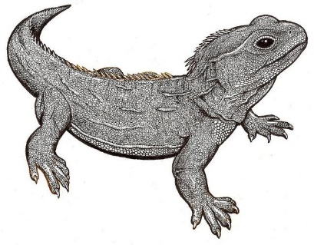
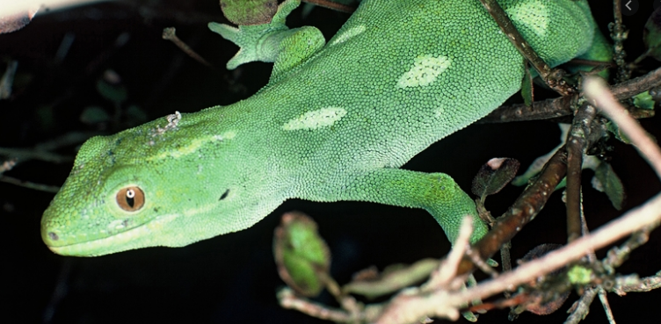
6.1. The impact of climate change on the biodiversity and ecology of New Zealand
Many aspects of New Zealand’s biodiversity will be impacted by climate change in some way. New Zealand has a number of unique indigenous ecosystems, and changing temperatures and water availability as a result of climate change will have impacts on where species can survive (RSNZ, 2016). The range of ecosystems and species will change, as will the timing of annual and seasonal events (eg, beech masting), and ecosystem functions (eg, food webs). Indirectly, climate change will increase the range and abundance of invasive pests and weed species which is currently a key driver of extinction.
Many of New Zealand’s unique species are highly specialised (eg, tuatara), limited in number (eg, takahe) and/or have specialised habitat requirements (eg, frogs and lizards). These factors will reduce their capacity to adapt to a changing climate.
Ministry for the Environment report – Adapting to Climate Change in New Zealand (from page 29 onwards for biodiversity)
https://www.mfe.govt.nz/sites/default/files/media/Climate%20Change/adapting-to-climate-change-stocktake-tag-report.pdf

Slide 28

Module 1 survey https://survey.alchemer.com/s3/6035974/Module-1-Climate-change-101-public-survey

Slide 29
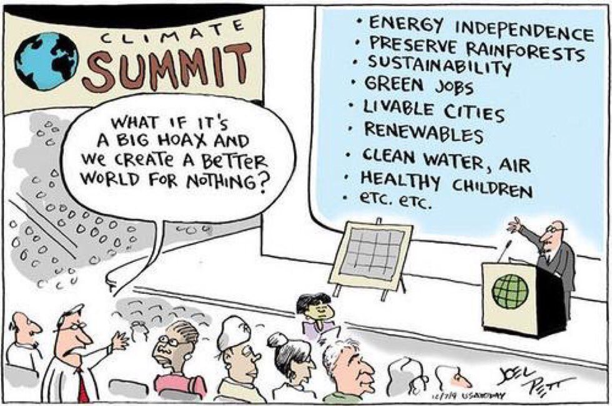
Next, in Module 2, we will be looking the need for us to act now including financial, legal, equity and cultural considerations and building resilience to natural hazard risk

