Slide 1
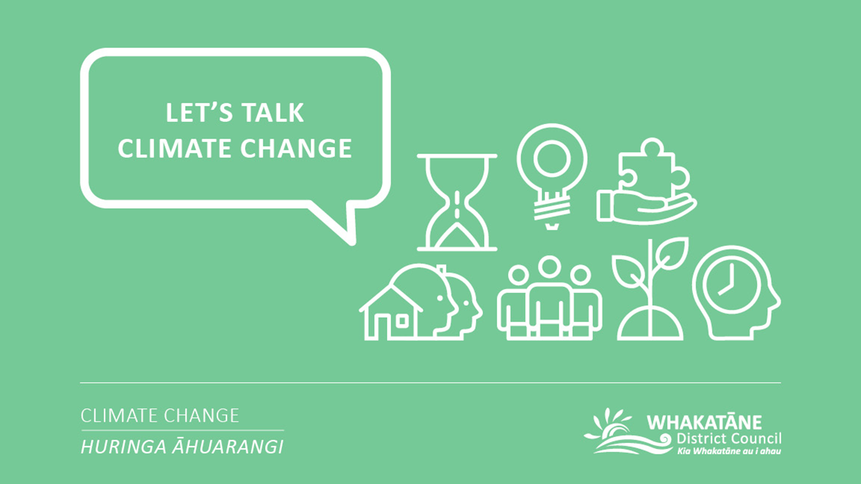
E-LEARNING

Slide 2
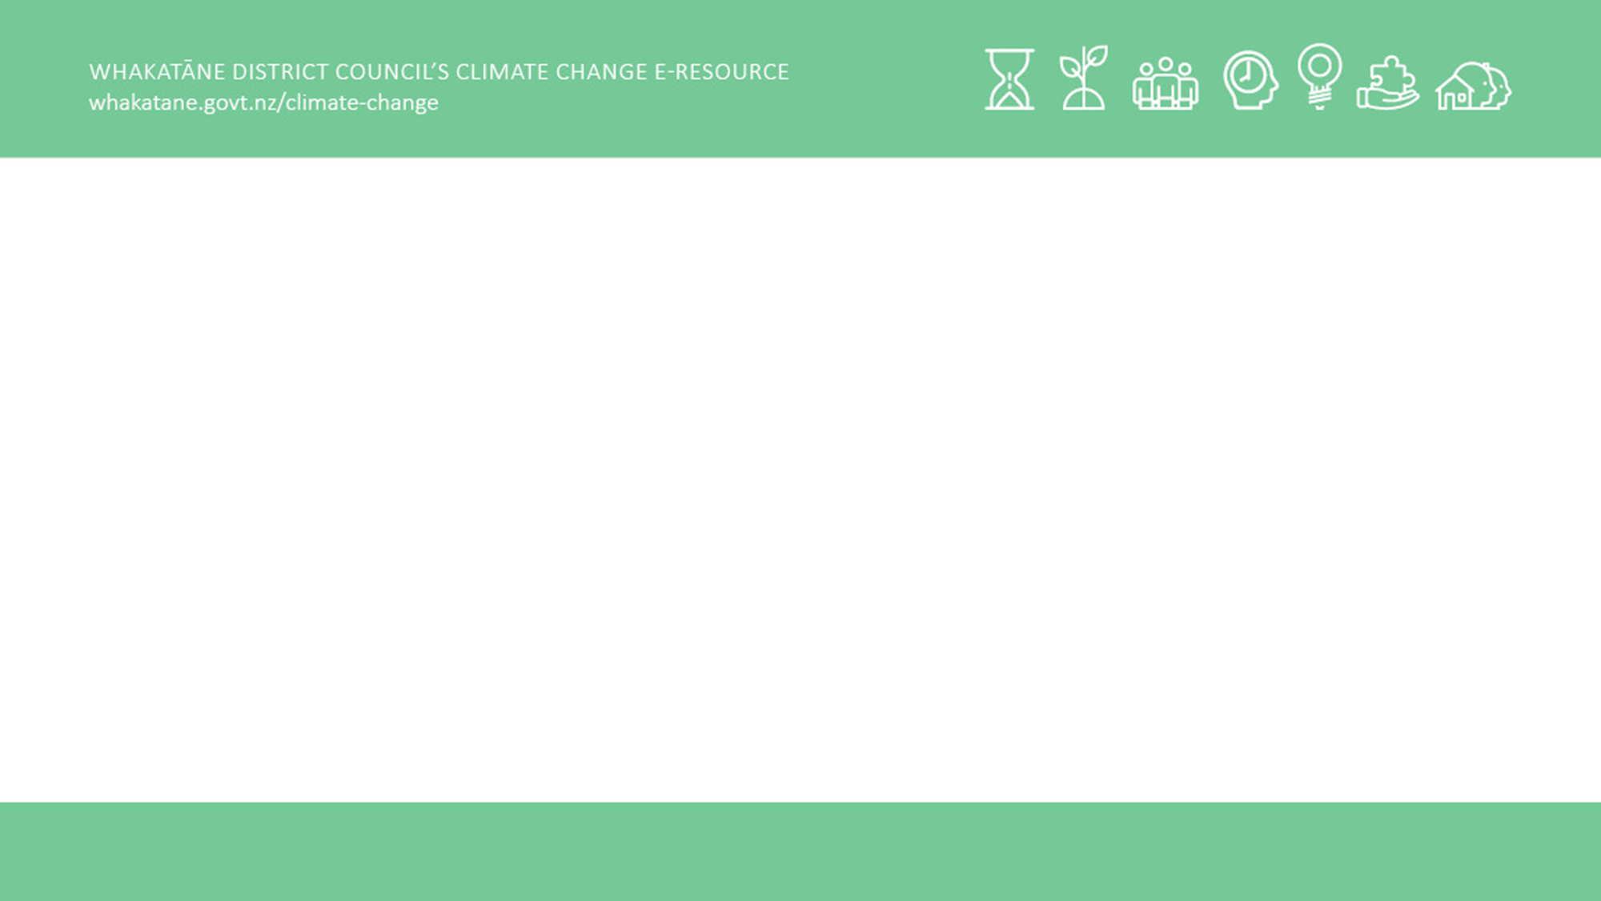
Whakatauki
Hāhā te whenua, hāhā te tangata
Desolate land, desolate people

Slide 3
Disclaimer:​
The information included in this e-learning hub has been compiled by the Whakatāne District Council to help us and our community on a journey of learning and development. The Council does not own and is not the authors of most of the content included in this hub. The Council has compiled content that we felt to be relevant, engaging and wherever possible to provide a local context. Further information regarding Council’s Climate Change Principles, our Climate Change project or our current engagement opportunities can we found on our project page:​
https://www.whakatane.govt.nz/climate-change

Slide 4
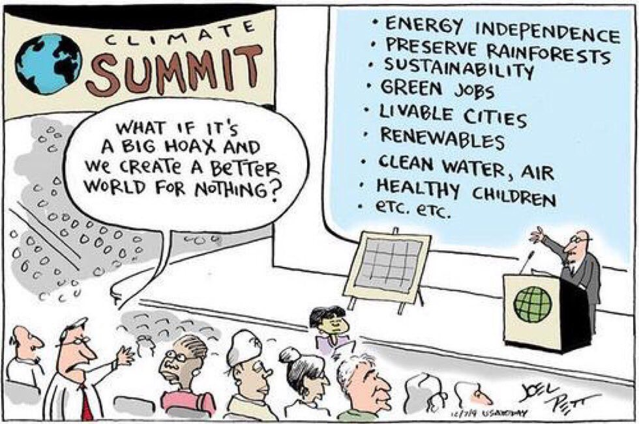
Module 2: The need to act now
This module includes:
1. The financial cost of not acting now
  1.1. Climate change is already costing us
  1.2. The costs of climate change for local government
2. The legal risks of not acting now
  2.1. Litigation risk
  2.2. What kind of litigation could occur?
  2.3. Litigation in New Zealand
3. Natural hazard risk and building resilience
3.1. All of Government Community Resilience Working Group
3.2. National Climate Change Risk Assessment Framework
3.3. Disaster Risk Reduction (DRR)
  3.4. The Sendai framework for disaster risk reduction
  3.5. TedTalk: From disaster response to disaster prevention
  3.7. Justifying the cost of disaster risk reduction
Learning statement for this module
What are the economic and social impacts of responding or not responding to climate change?

Slide 5
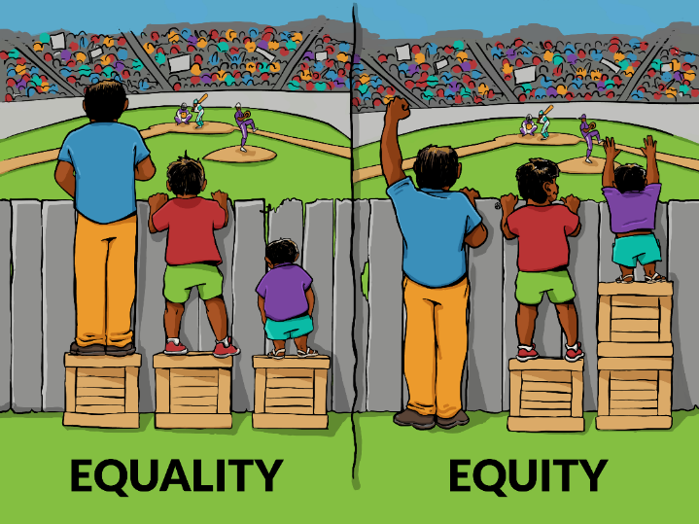
4. Equity and justice
  4.1. The disproportionate impacts of climate change
  4.2. The disproportionate impact of climate change on Māori
  4.3. Equity – a health care perspective
  4.4. Sharing the risks of sea level rise fairly
  4.5. Climate justice and intergenerational equity
  4.6. World Leaders Forum – The climate sustainable welfare society: is it the model of the future?
  4.7. Just Transitions
  4.8. The Sustainable Development Goals
5. Assessing climate change from a culturally appropriate context
  5.1. Vision Mātauranga
  5.2. ‘Changing with our climate’ Deep South Challenge panel discussion.
  5.3. ‘Climate resilient Māori land’ project update.
  5.4 Deep South Challenge Research: The Living Net – Kai in a Changing Climate
  5.5. List of Iwi/Hapū Management Plans/Environmental Plans in the BOP area.

Slide 6
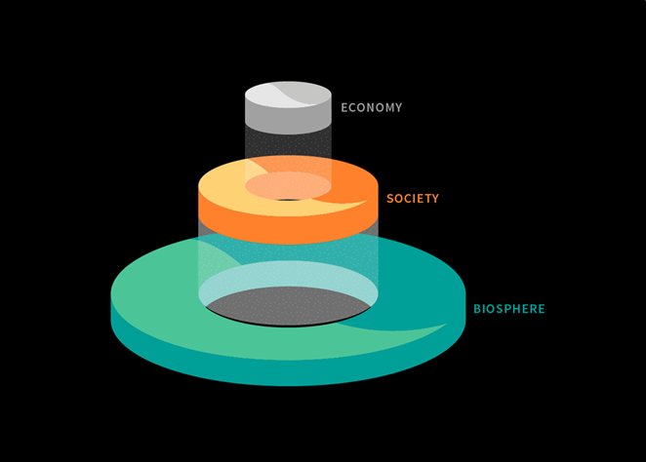
We looked at the impact of climate change on the biosphere in Module 1.
In this module, we will turn our focus on the impact of climate change on our economy and society.
Let’s start with the $$$.

Slide 7
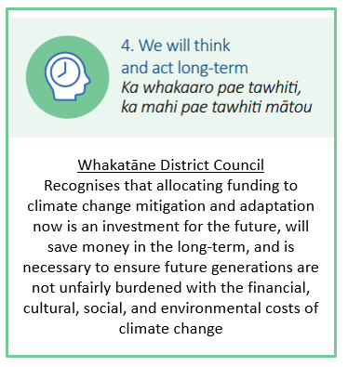






1. The financial cost of not acting now
1.1. Climate change is already costing us
Extract from the New Zealand Herald article:
The 2007/08 and 2012/13 droughts jointly reduced GDP in New Zealand by around $4.8 billion. Around $800 million of this cost is estimated to be due to climate change. The most costly 12 extreme weather events that caused flooding in the period 2007-18, contributed around $140 million in insurance losses that were caused because of climate change.
Climate change is already causing significant losses to New Zealand. Climate change is not only a future problem, but it is costing us here and now.
Read the full article:
https://www.nzherald.co.nz/nz/news/article.cfm?c_id=1&objectid=12326761

Slide 8
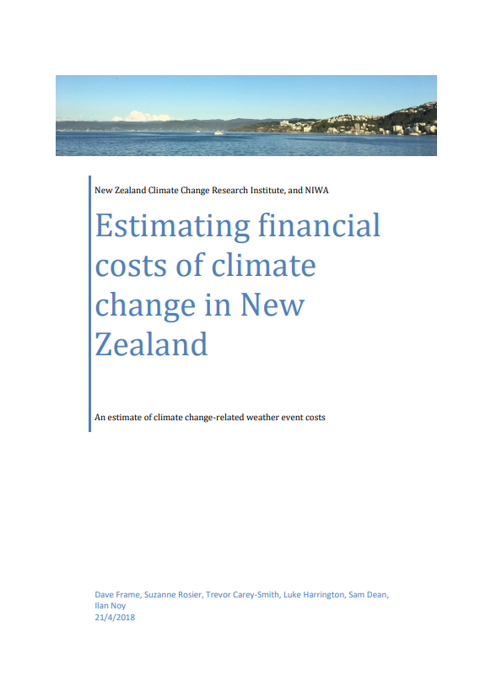
Estimating financial costs of climate change in New Zealand
A report by Victoria University and NIWA commissioned by The Treasury, which draws on international scientific peer reviewed evidence, has found that climate change related floods and droughts cost the New Zealand economy at least $120M for privately-insured damages from floods and $720M for economic losses from droughts from mid-2007 to mid-2017.
This is expected to be a conservative estimate due to the inclusion of only two weather-related hazards, the choices made regarding the attribution of droughts, the neglect of nonfinancial losses, and the use of insured damages rather than full economic losses for some events. Climate change attributable costs are expected to increase in future years due to enhanced development in areas vulnerable to climate change, and to the on-going emergence of stronger climate change signals.
This report does not include other weather events such as wildfires or hail, as there is currently insufficient climate change attribution research conducted for these impacts on New Zealand, and the report does not include the wider impact on ecosystems.
The intention of the report is to provide an indicative assessment of some of the more readily addressed costs associated with climate change, with a view towards creating a forward liability for climate that could, for example, be used in cost-benefit analysis of infrastructure resilience investments and other climate change-related policies.
Full report:
https://treasury.govt.nz/publications/commissioned-report/estimating-financial-costs-climate-change-nz

Slide 9
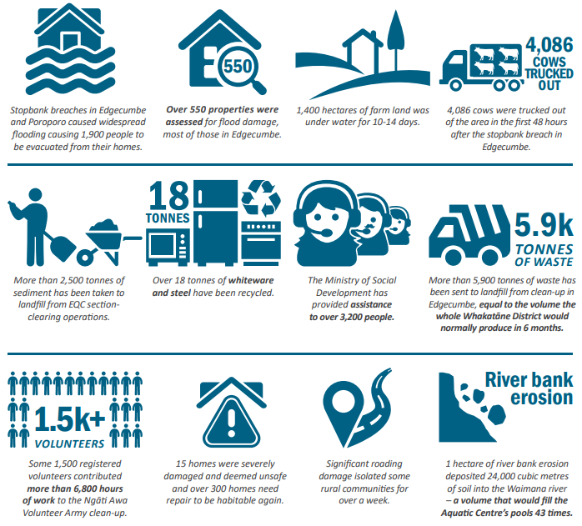
Case study: Edgecumbe Floods
In April 2017, the Whakatāne District experienced widespread damage to homes, property, businesses, farms and infrastructure as a result of extreme weather generated by ex-Cyclone Debbie and ex-Cyclone Cook. On 7 April 2017, the Rangitaiki River breached a stopbank at Edgecumbe. Over the next 48 hours, thousands of cubic meters of water flooded the township, inundating over 450 buildings.
A RiskScape research team surveyed the flood hazard, building and infrastructure damage and residents’ responses to flood warnings. RiskScape estimated building repair and disruption costs of NZD$19.6m for the 220 homes surveyed, just under NZD$90,000 per home. Component damage was 20% - 70% of building replacement costs. Average loss of contents was 60%.
The Insurance Council, which represents general insurers like Vero and IAG, said claims from the two storms look likely to cost its members $109m.
RiskScape information: https://www.riskscape.org.nz/surveying-flood-damage-edgecumbe
Insurance Council article: https://www.stuff.co.nz/business/96155001/cost-of-cyclones-debbie-and-cook-rises-to-109-million

Slide 10
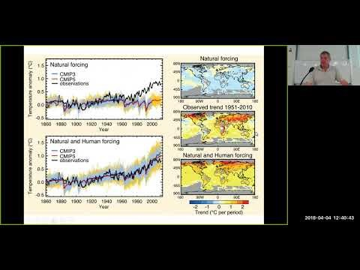


Deep South Challenge Seminar: Counting the Cost of Climate Change (Treasury Redux)
Climate change is already making day-to-day life more precarious and more expensive. New Zealanders are increasingly interested in climate adaptation strategies. Conversations about the cost of early adaptation versus the risk of delayed action are growing in volume.
Researchers from the Deep South National Science Challenge are working on a huge range of climate adaptation issues. They are addressing urgent questions about the climate resilience of our infrastructure. They are asking who will pay for climate adaptation, and how. And they’re developing important solutions to the problem of decision-making in an uncertain future.
This seminar is an abridged version of the Treasury Guest Lecture delivered in early-March. While it is about one hour long, this is a great introduction to the work of the Deep South Challenge.
1h
https://youtu.be/ju1L7V94NPM (12.05.2020)
More about the Deep South Challenge:
www.deepsouthchallenge.co.nz

Slide 11
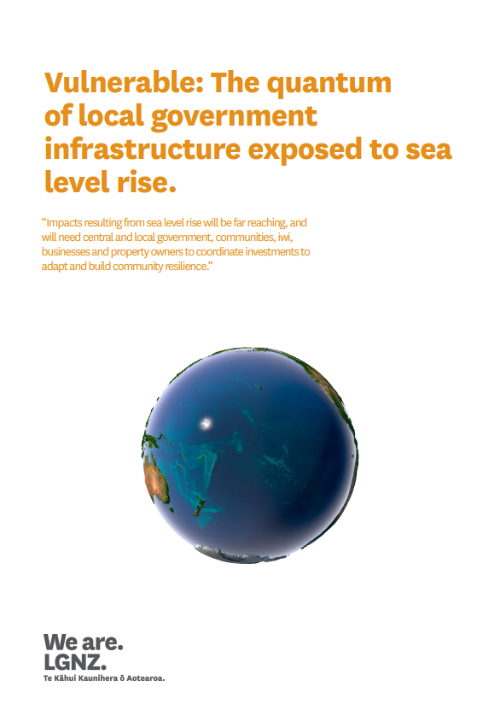

1.2. The costs of climate change for local government
Mitigating and responding to climate change will be costly, and significant costs will fall on local government. For example, LGNZ has gathered critical evidence identifying the current quantity and replacement value of infrastructure exposed to sea level rise at four increments. Although the focus was primarily on roads, three waters infrastructure and buildings, data was collected on all available owned infrastructure (such as greenspace, jetties and airports).
The analysis reveals that the total replacement value of all exposed infrastructure at the 1.5 metre increment is estimated at approximately $8 billion. Importantly, at each noted increase of sea level rise between 0.5 and 3.0 metres, the incremental increase in value is between 50 and 90 per cent. Notably, between 1.5 and 3.0 metres, the increase is an approximate doubling of value exposed creating a total estimated value greater than $13 billion.
The greatest value of exposed local government owned infrastructure is different at varying increments. Generally, at the 1.5 metre increment, Canterbury’s exposure is the greatest, followed by the Hawke’s Bay and by Auckland. Additional noted areas include Greater Wellington, Bay of Plenty, Otago, and Waikato.
Full report:
https://www.lgnz.co.nz/assets/Uploads/d566cc5291/47716-LGNZ-Sea-Level-Rise-Report-3-Proof-FINAL-compressed.pdf

Slide 12
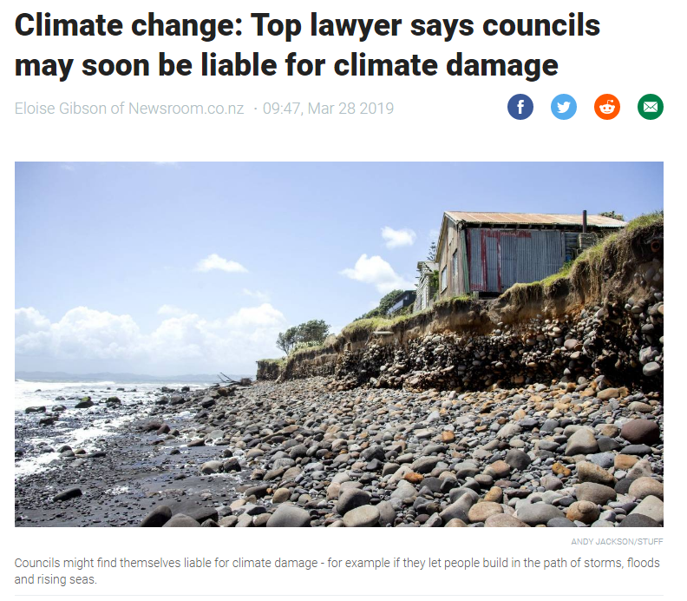

2. The legal risks of not acting now
2.1. Litigation risks
LGNZ has commissioned a legal opinion from Jack Hodder QC, gauging the litigation risks that councils face by choosing to recognise or ignore climate change-related risks in their decision-making. Hodder found an increasing number of climate change-related law suits being brought by individuals and communities frustrated by a lack of progress on climate change internationally, and reasoned that it is only a matter of time before similar actions are taken in New Zealand.
A key risk raised is the absence of national climate change adaptation guidance in New Zealand, effectively leaving it to the courts to decide how to remedy climate change-related harms. LGNZ President Dave Cull noted that Mr Hodder’s report shone a vital spotlight on the tough position councils are in: On one hand there was no legislative framework to support decisions that reflect climate change risks. On the other hand, ratepayers – through councils – potentially faced significant costs through legal action by not adequately factoring climate risks into their decision-making, that subsequently result in physical or economic harm.
Full article:
https://www.lgnz.co.nz/our-work/publications/climate-change-litigation-whos-afraid-of-creative-judges/

Slide 13
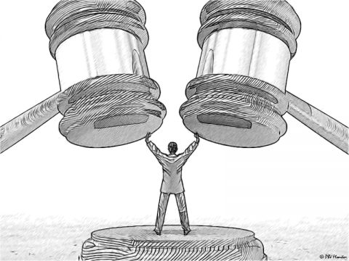
2.2. What kind of litigation could occur?
Claims under the Bill of Rights Act
Interpretations of Section 8 (Right not to be deprived of life) or Section 9 (Right not to be subjected to torture or cruel treatment) of the Bill of Rights Act could relate to disproportionately severe treatment of a person or persons through climate change effects due to actions or lack of actions by the Council.
Tort law
Tort law is an area of law that deals with the wrongful actions of an individual or entity, which cause injury to another individual’s or entity’s person, property, or reputation, and which entitle the injured party to compensation. A tort liability could relate to negligence or failure to act.
Judicial Review
If the Council has made a decision under a power granted by an Act, an application may be able to be made to the High Court for a “judicial review” of the particular decision.

Slide 14
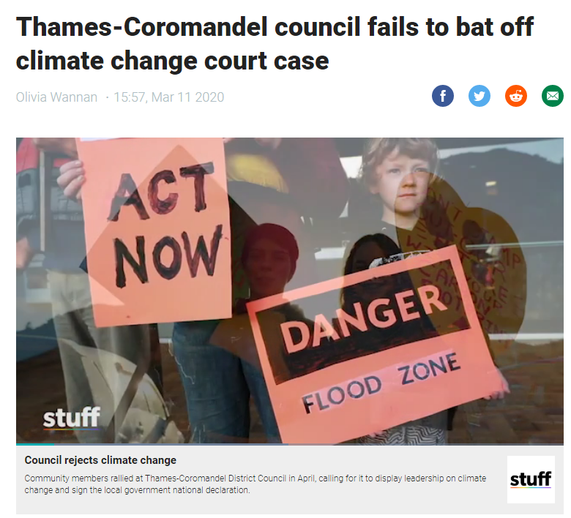
Case study – Judicial Review: Thames-Coromandel District Council
Extract:
“Climate change activists have won an early legal battle against Thames-Coromandel District Council and won't have to stump up $25,000 for their day in court, the High Court ruled.
Hauraki Coromandel Climate Action hopes the High Court will quash the council's decision in April (2019) not to sign the Local Government New Zealand climate change declaration.
After it was served with court documents in July, the council tried to have the legal action thrown out. Lawyers for the council also argued that the climate activist group should be required to hand over $25,000 as security, to cover the council's legal costs in case the council won the legal proceedings. The judge ruled against the council on both counts in a decision released this week (March 2020).”
Read the full article:
https://i.stuff.co.nz/environment/climate-news/120175034/thamescoromandel-council-fails-to-bat-off-climate-change-court-case

Slide 15
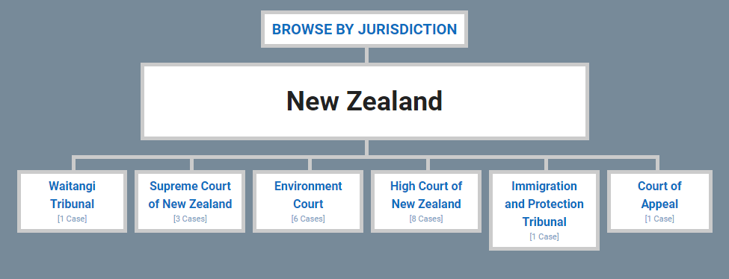
2.3. Litigation in New Zealand
Climatecasechart.com is a website which provides databases of climate change litigation, one for U.S. climate change litigation and one for non-U.S. cases. It currently shows 18 cases of climate change litigation in New Zealand.
Details on each case:
http://climatecasechart.com/non-us-jurisdiction/new-zealand/

Slide 16
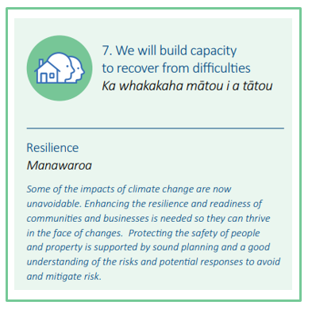
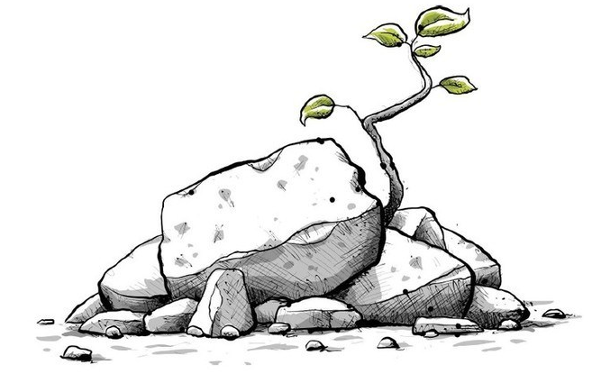
3. Natural hazard risk and building resilience
Risk is often expressed in terms of a combination of the consequences of an event and the likelihood of that event occurring. The Intergovernmental Panel on Climate Change describes climate risks as:
“Climate change will amplify existing risks and create new risks for natural and human systems. Risks are unevenly distributed and are generally greater for disadvantaged people and communities in countries at all levels of development.” (IPCC, 2014)
The Whakatāne District is already vulnerable to natural hazards including slips, flooding, coastal erosion and inundation. Climate change is likely to exacerbate the consequences of these hazards. Building resilience is crucial.
In our Climate Change Principles, we define resilience as “the ability to anticipate, minimise, absorb, respond to, adapt to, and recover from disruptive events.”
One of the changes introduced by the Resource Legislation Amendment Act 2017 is that “the management of significant risks from natural hazards” is a matter of national importance in Section 6 of the RMA, a key guiding document for councils.

Slide 17
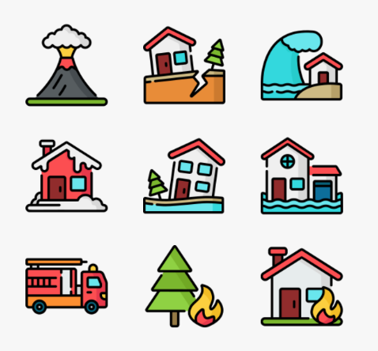

3.1. All of Government Community Resilience working group
The Central/Local Government Partnerships (CLGP) team within the Department of Internal Affairs was established in mid-2017 to facilitate a collaborative system-wide, public service approach in which central and local government work effectively together for the benefit of people, communities, business, and the environment.
The CLGP team is leading an inter-agency approach to strengthen community resilience in the face of natural hazards and the effects of climate change. This work has been commissioned in partnership with Local Government New Zealand and involves a number of case studies where the CLGP team is working directly with Councils to manage natural hazards at Kaikōura, Matatā and Franz Josef.
The community resilience work programme involves five areas to enable communities to better invest in risk reduction and adaptation activity:
          1. Information to support better decision making.
          2. Enhanced use of risk assessment.
          3. Enabling better decision making in the resource management system for natural hazard risk management and adaptation to the effects of climate change.
          4. Insurance markets and risk financing.
          5. Principles and approaches to funding and financing.
More on the CLGP team on the Department of Internal Affairs webpage:
https://www.dia.govt.nz/Central-Local-Government-Partnership

Slide 18
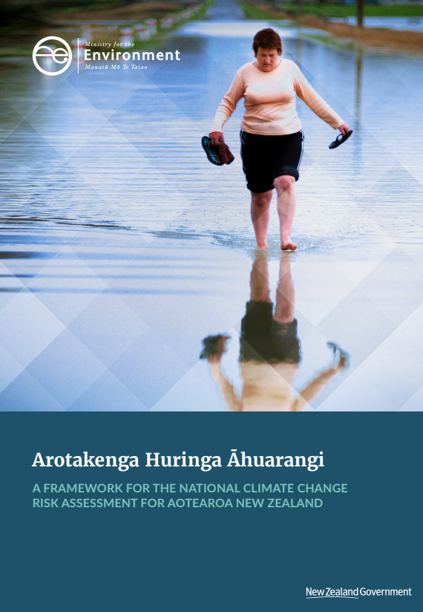

3.2. National Climate Change Risk Assessment Framework
The first national climate change risk assessment will identify the most significant risks New Zealand faces from climate change. This will enable the Government to prioritise action, including through a national adaptation plan. The national adaptation plan will compliment and build on the actions New Zealand is already taking to respond to the impacts of climate change.
A framework, Arotakenga Huringa Āhuarangi, was published in September 2019 to carry out the national climate change risk assessment. It allows for a range of risks to be compared according to their nature, severity and urgency. It combines scientific, technical and expert information including Mātauranga Māori, local knowledge and experience. This framework can be used by local government, iwi/Māori and other organisations to perform their own climate change risk assessments.
The first national climate change risk assessment report is on-track to be publicly released later this year. It will be very high level. The Government will plan and prioritise action to respond to the most significant risks identified in the risk assessment through a national adaptation plan. Under the Climate Change Response Act, the national adaptation plan must be delivered two years after the risk assessment is completed.
The framework, and upcoming report, will provide guidance to local risk assessments which will provide valuable data for future national risk assessments.
More information:
https://www.mfe.govt.nz/climate-change/assessing-climate-change-risk

Slide 19
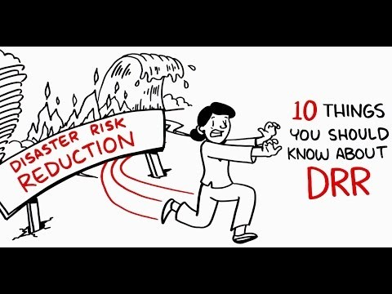

3.3. Disaster Risk Reduction (DRR)
What is disaster risk reduction (DRR)?
The most commonly cited definition of DRR is one used by UN agencies such as UNISDR, also known as the UN Office for Disaster Risk Reduction, and UNDP: "The conceptual framework of elements considered with the possibilities to minimize vulnerabilities and disaster risks throughout a society, to avoid (prevention) or to limit (mitigation and preparedness) the adverse impacts of hazards, within the broad context of sustainable development."
4min
https://youtu.be/y16aMLeh91Q (22/05/2020)
More info:
https://www.preventionweb.net/risk/drr-drm

Slide 20
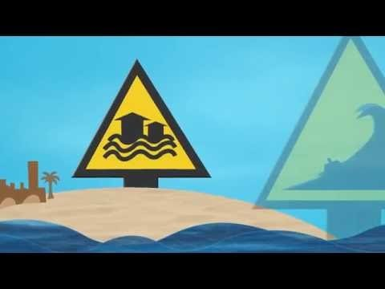
3.4. The Sendai Framework for Disaster Risk Reduction
The Sendai Framework for Disaster Risk Reduction 2015-2030 works hand in hand with other 2030 agenda agreements like The Paris Agreement and the Sustainable Development Goals (SDGs) and advocates for:
“The substantial reduction of disaster risk and losses in lives, livelihoods and health and in the economic, physical, social, cultural and environmental assets of persons, businesses, communities and countries.”
The Sendai Framework for Disaster Risk Reduction has four main priorities:
Understanding Disaster Risk,
Strengthening Disaster Risk Governance,
Investing in Disaster Risk Reduction for Resilience,
The importance of Disaster Preparedness.
New Zealand is a signatory to the Sendai Framework.
https://youtu.be/M9m6mb-blYM (22/05/2020)
4min
For more information on the Sendai Framework and the United Nations Office for Disaster Risk Reduction (UNISDR):
https://www.undrr.org/

Slide 21
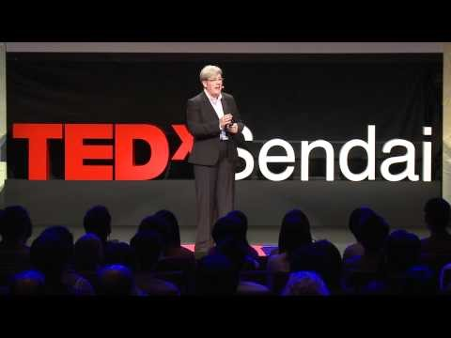
3.5. TedTalk: From disaster response to disaster prevention
12min
https://youtu.be/cWYcXhMhJF4 (22/05/2020)
For more information on the Sendai Framework and the United Nations Office for Disaster Risk Reduction:
https://www.undrr.org/

Slide 22
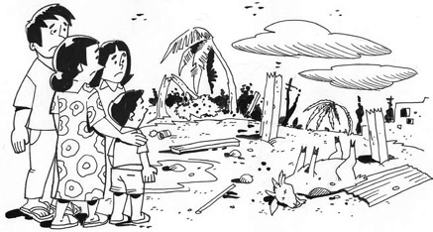




3.7. Justifying the cost of disaster risk reduction
Extract from the article:
“Evidence on the costs and benefits of DRR consistently shows that investment brings greater benefits than costs, and therefore should be a priority for development planning. However, this evidence is limited and very location- and hazard-specific. Further work is needed to demonstrate to finance ministers and donors that mainstreaming DRR is financially and economically justified.”
Read the full article here:
https://odihpn.org/magazine/justifying-the-cost-of-disaster-risk-reduction-a-summary-of-cost%C2%96benefit-analysis/
The Humanitarian Practice Network (HPN) was established in 1994 to provide an independent forum for policy-makers, practitioners and others working in or on the humanitarian sector to share and disseminate information, analysis and experience, and to learn from it. The only network of its kind, HPN plays a key role in examining policy developments and distilling practice.
Learn more about the Humanitarian Practise Network:
https://odihpn.org/
Cost-benefit analysis of Disaster Risk Reduction article:
https://www.aktion-deutschland-hilft.de/fileadmin/fm-dam/pdf/publikationen/aktion-deutschland-hilft-studie-zur-katastrophenvorsorge-englische-version-english-version.pdf

Slide 23
So far, we’ve looked at the impact of climate change on the biosphere and our economy.
Next we will discuss climate change from a societal viewpoint.

Slide 24
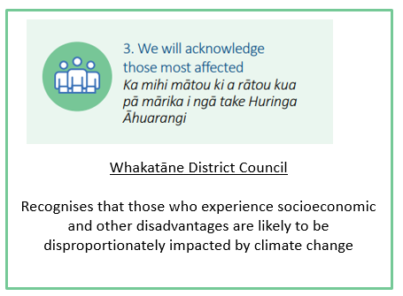
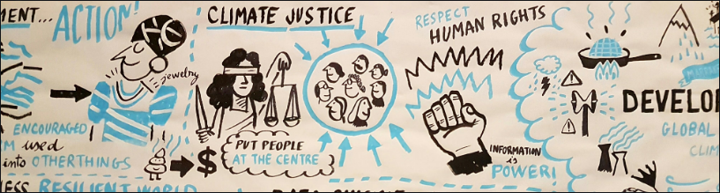

4. Equity and justice
Climate justice movements have long talked about what a fair response to the crisis looks like, and have maintained that responsibility should be allocated in a fair way between rich and poor countries, and between rich and poor people within countries. Wealthy countries and elites that have caused the climate problem must do the most to fix it and those who have done the least to cause it but are most affected must be given support to cope.
The United Nations Framework Convention on Climate Change (UNFCCC) also makes clear that all countries must contribute to climate action in accordance with their (common but differentiated) historical responsibility and current capacity. These are what are referred to as the equity principles.

Slide 25
  4.1 The disproportionate impacts of climate change
The 2017 Stocktake Report from the Climate Change Adaptation Technical Working Group notes that:
“The impacts of climate change will not be evenly distributed around New Zealand. Vulnerability to climate change depends on level of exposure to the change and ability to cope and adapt to the change… The most vulnerable will be those who do not have the resources to adapt. Based on this, communities we consider could be more vulnerable to the expected impacts of climate change include:
• Māori – their significant reliance on the environment as a cultural, social and economic resource makes Māori vulnerable to the impacts, some of which they are already experiencing, as their livelihoods are exposed to the impacts of climate change on the natural environment. For example, the Māori economy relies heavily on primary industries. Different Māori communities face different climate change risks, as some communities will be more vulnerable to the impacts of climate change than others.
• Communities in low lying areas – people living close to the coast and on floodplains are more exposed to flooding and other coastal hazards, the frequency and intensity of which are expected to increase as a result of climate change. Not all of these communities are equally vulnerable as their ability to adapt will differ.
• Rural communities dependent on non-reticulated water resources (eg, rain water tanks) – increased pressure on freshwater resources is an expected impact of climate change (RSNZ, 2016), and the effects of changing hydrological regimes on drinking water availability are expected to seriously affect these places and populations.
There is very little research on which groups and locations in New Zealand are at the greatest risk from climate change impacts.
This is an information gap.”
Read the full report:
https://www.mfe.govt.nz/sites/default/files/media/Climate%20Change/adapting-to-climate-change-stocktake-tag-report.pdf

Slide 26
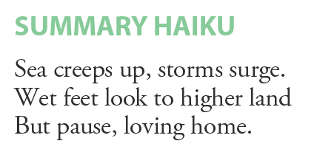
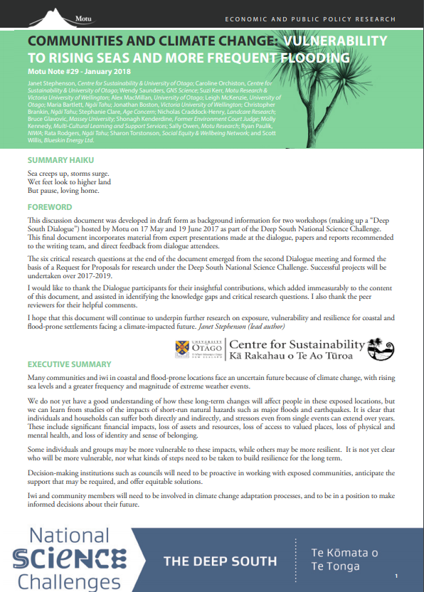

  4.1 The disproportionate impacts of climate change (con’t)
In April 2018, Motu (an economic research institute in New Zealand) published Mōtū Note #29: Communities and climate change: vulnerability to rising seas and more frequent flooding.
The below is an extract from the Executive Summary of the paper.
Many communities and iwi in coastal and flood-prone locations face an uncertain future because of climate change, with rising sea levels and a greater frequency and magnitude of extreme weather events.
We do not yet have a good understanding of how these long-term changes will affect people in these exposed locations, but we can learn from studies of the impacts of short-run natural hazards such as major floods and earthquakes. It is clear that individuals and households can suffer both directly and indirectly, and stressors even from single events can extend over years. These include significant financial impacts, loss of assets and resources, loss of access to valued places, loss of physical and mental health, and loss of identity and sense of belonging.
Some individuals and groups may be more vulnerable to these impacts, while others may be more resilient. It is not yet clear who will be more vulnerable, nor what kinds of steps need to be taken to build resilience for the long term.
Decision-making institutions such as councils will need to be proactive in working with exposed communities, anticipate the support that may be required, and offer equitable solutions. Iwi and community members will need to be involved in climate change adaptation processes, and to be in a position to make informed decisions about their future. Sometimes, people may already be facing financial, physical and mental stresses from impacts such as flooding and erosion, and at the same time may need to be involved in planning for a changing future. The social, cultural and psychological challenges could be immense, so response and adaptation processes need to be carefully designed and delivered, especially for the more vulnerable.
Read the full report:
https://motu.nz/assets/Documents/our-work/environment-and-agriculture/climate-change-impacts/Communities-and-Climate-Change-Report2.pdf

Slide 27
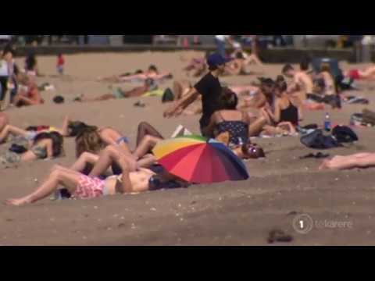
  4.2. The disproportionate impact of climate change on Māori
As noted on a previous slide, the 2017 Stocktake Report from the Climate Change Adaptation Technical Working Group considers that Māori could be more vulnerable to the expected impacts of climate change. Page 11 of the report notes that:
For Māori, their reliance on the environment as a cultural, social and economic resource makes them exposed to climate change impacts. Different iwi face different risks, and some are more vulnerable than others. There are numerous marae, cultural heritage and food gathering sites in coastal low-lying areas that are at risk of being lost by sea erosion and inundation.
Page 40 of the report includes a quote from the Climate Change Iwi Leaders Group:
“The climate is changing where Iwi in the South talk of the Titi (mutton birds) having today a 4 in 7 bad year where once it was 1 in 7 and they call for a much more holistic (kaitiakitanga) solution to climate change. Iwi in the East talk about their roadways being washed away and serious soil erosion. While an Iwi in the North talks about all 14 of their marae facing inundation from rising sea levels and flooding. Iwi in the West talk too about flooding while those Iwi in the Central North Island call on government to help with new afforestation. And meanwhile the science tells us that these issues are only going to get worse…… The legacy of our generations is at stake.”
https://www.youtube.com/watch?v=Bi0GQcR8zJo
2min
For the full stocktake report:
https://www.mfe.govt.nz/sites/default/files/media/Climate%20Change/adapting-to-climate-change-stocktake-tag-report.pdf

Slide 28
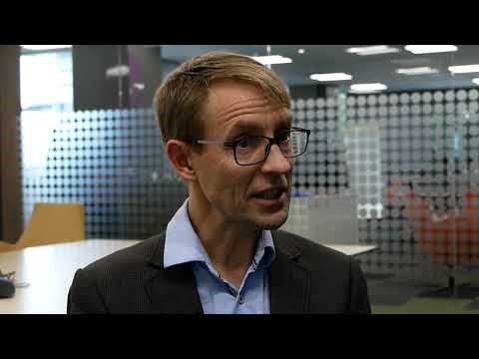


  4.4. Equity – a healthcare perspective
The New Zealand Ministry of Health has defined ‘equity,’ and states:
‘Having a common understanding of equity is an essential foundation for coordinated and collaborative effort to achieve equity in health and wellness. The definition can be used in all work and engagements within the health and disability system including government agencies involved in the broader social and economic determinants of health. The definition can provide a common understanding of what is meant by equity.’
The Ministry’s definition of equity is:
In Aotearoa New Zealand, people have differences in health that are not only avoidable but unfair and unjust. Equity recognises different people with different levels of advantage require different approaches and resources to get equitable health outcomes.
This definition was signed-off by Director-General of Health, Dr Ashley Bloomfield, in March 2019.
https://www.youtube.com/watch?v=MmxS2ZdjmJY#action=share

Slide 29
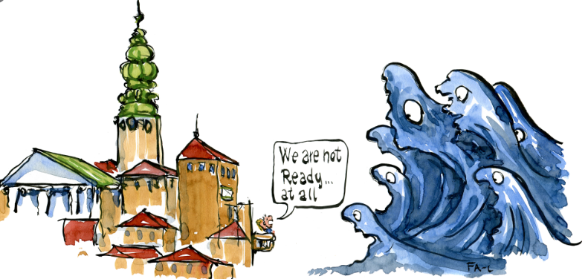
  4.5. Sharing the risks of sea level rise fairly
Facing the faraway threat of sea-level rise, responses range from, “Your place, your problem!”, to “Don’t worry, the government will take care of it.” But unless we consider the issue and respond ethically, it’s very likely that the risks of sea-level rise will not be shouldered fairly.
Research recently concluded in the Deep South Challenge: Changing with our Climate, has found that without a new legal framework to deal with sea-level rise, based on a broad social consensus, the risk will be transferred from the least to the most vulnerable.
The research report, How should the risks of sea-level rise be shared?, by Elisabeth Ellis from the University of Otago, addresses a key question that emerged from a Deep South Dialogue between insurance companies and researchers: On a principled level, how should the risks of sea level rise be distributed between individuals, insurance, local and central government? Should we choose to view responsibility as individual or collective? And either way, which approach delivers the best and fairest outcomes?
“If we stick with the status quo,” Ellis says, “the way we adjust to sea level rise will exacerbate existing inequality. Nobody in New Zealand wants that,” she continues. “They want policy to be in line with consensus ethical values. They want the government to do what people think is right.”
More info: https://www.deepsouthchallenge.co.nz/news-updates/not-my-problem-sharing-risks-sea-level-rise-fairly
Project page: https://www.deepsouthchallenge.co.nz/projects/how-should-risks-sea-level-rise-be-shared

Slide 30
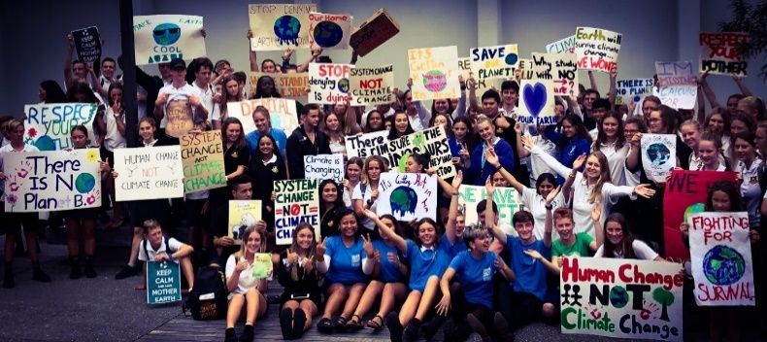

4.6. Climate justice and intergenerational equity
A significant question around climate change impacts is where the costs will fall and who will bear them – current or future generations?
How we address and provide for intergenerational equity in our systems and decision-making around climate change impacts is a gap in our current understanding. What we do know is that costs of adapting will increase over this century. Not addressing these would also place a financial burden on future generations.
Youth across the world have shared their concerns about climate change through the School Strikes for Climate, including in the Whakatāne District.
Whakatāne youth at Wharaurangi part of the School Strike for Climate 2019 movement
Case study on youth perspectives (page 92):
https://www.mfe.govt.nz/sites/default/files/media/Climate%20Change/adapting-to-climate-change-stocktake-tag-report.pdf
Find out more on the School Strikes for Climate here:
https://www.schoolstrike4climate.nz/

Slide 31

4.6. Climate justice and intergenerational equity (con’t)
Jonathan Boston (School of Government, Victoria University of Wellington) and Judy Lawrence (New Zealand Climate Change Research Institute, Victoria University of Wellington) have produced a paper laying out the case for new climate change adaptation funding instruments. The paper notes that ‘…The design of a funding framework for climate change adaptation could be conceptualised with two overarching goals – namely, efficiency and equity (or distributive justice):
1. Efficiency – funding arrangements should seek to minimise the long-term net costs of climate change adaptation by encouraging cost-effective decisions regarding district planning and investment in public infrastructure. The aim would be to reduce the likely costs of climate-related impacts (e.g. major floods) through cost-effective measures to future-proof infrastructure or undertake managed retreat (or both). Successful adaptation will, in turn, help to reduce future insurance (including EQC) costs, thereby keeping insurance more affordable and available. Consistent with this, funding arrangements, and related planning and regulatory frameworks, must be well coordinated and designed to minimise moral hazard (e.g. the risk of giving individuals, companies or other organisations incentives to act in ways that are likely to increase overall adaptation costs and/or shift costs inappropriately onto taxpayers or ratepayers).
2. Equity – funding arrangements should be consistent with widely accepted principles of distributive justice, and as fair as possible to all affected parties. Such principles need to be applied in two ways:
intergenerationally: that is, sharing the costs of adaptation fairly over extended time horizons (e.g. at least 100 years); and
b. intra-generationally: that is, sharing the costs of adaptation fairly between citizens at any given point in time, including how costs are shared between the different tiers of government (central, regional and local), between different regions, and between the public and private sectors.
Read the full paper:
https://www.victoria.ac.nz/__data/assets/pdf_file/0005/1175243/WP17-05-Climate-change-adaptation.pdf

Slide 32


4.7. World Leaders Forum – The climate sustainable welfare society: is it the model of the future?
The World Leaders Forum is a year-round event series at Columbia University that has hosted over 100 heads of state and world leaders from over 85 countries since it was first established in 2003 by President Lee C. Bollinger.
The Forum offers a unique venue for world leaders from countries and organizations small and large to engage in discussions related to the major issues of our time.
In this talk, Ms. Sanna Marin, the Prime Minister of the Republic of Finland discusses the critical intersection of climate change, gender equality and social welfare.
1h
https://youtu.be/umzg8Keyybo (15.05.2020), please start at 7.20min in.
Find out more:
https://worldleaders.columbia.edu/

Slide 33
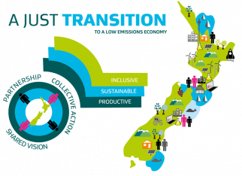
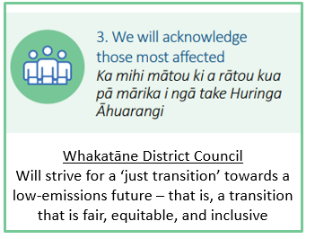
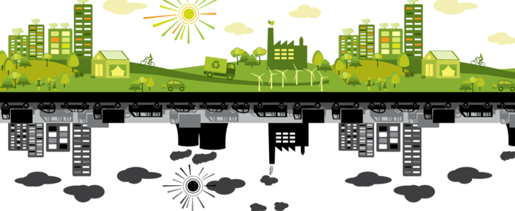

  4.8: Just Transition
The need to mitigate and adapt to the impacts of climate change, including grasping the opportunities that it presents, will shape New Zealand’s transition to a low emissions economy.
The Ministry for Business, Innovation, and Employment has established a Just Transitions Unit to help share and coordinate the work of this transition.
A “just transition” is one that is fair, equitable and inclusive. It is about making sure that the Government carefully plans with iwi, communities, regions and sectors to manage the impacts and maximise the opportunities of the changes brought about by the transition to a low emissions economy.
More information:
https://www.mbie.govt.nz/business-and-employment/economic-development/just-transition/

Slide 34
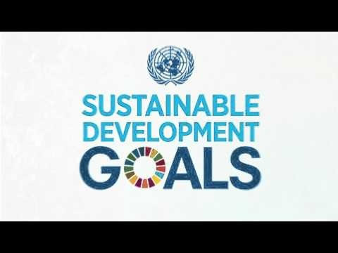
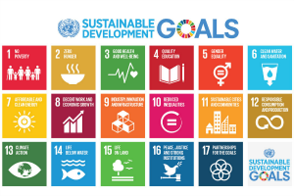

4.9. United Nations Sustainable Development Goals (SDGs)
The UN Sustainable Development Goals (SDGs) are the blueprint to achieve a better and more sustainable future for all.
They address the global challenges we face, including those related to poverty, inequality, climate change, environmental degradation, peace and justice.
All 17 goals are interconnected, and in order to leave no one behind, it is important that we achieve them all by 2030.
3min
https://youtu.be/5_hLuEui6ww (14.05.2020)
Learn more about the UN Sustainable Development Goals:
https://www.un.org/sustainabledevelopment/sustainable-development-goals/

Slide 35
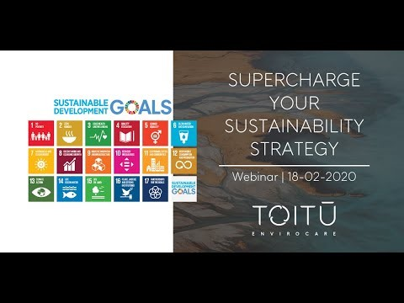

United Nations Sustainable Development Goals (con’t)
This is a webinar from Toitū Envirocare. It discusses how the UN Sustainable Development Goals are essential for businesses to align actions with impact for sustainability.
Understand more about the Goals, the business imperative for alignment, the key steps for successful integration and see examples from organisations who’ve started on the journey.
Hear from Toitū Envirocare’s SDG expert – Sophia White, along with Amy Hughes, Wellington Zoo’s General Manager Communication, Experience and Conservation, and Gary Walker, Auckland District Health Board’s Project Manager – Sustainable Development Goals Alignment.
1hr
https://youtu.be/rUbsNJfeVM8 (14/05/2020)

Slide 36
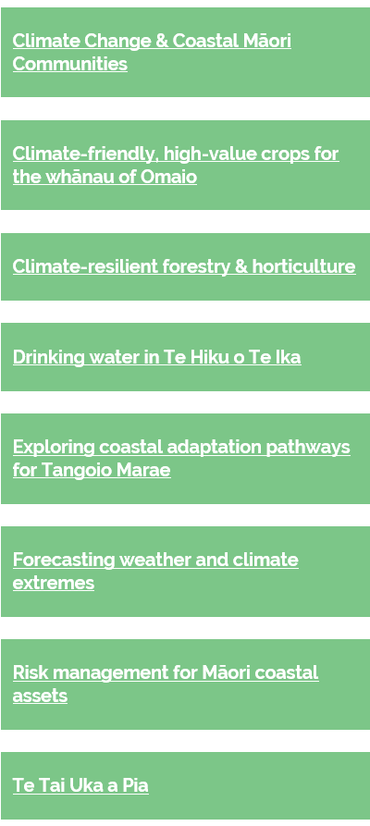
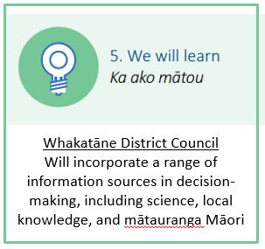
5. Assessing climate change from a culturally appropriate context
  5.1. Vision Mātauranga
The Deep South Challenge has a programme called Vision Mātauranga. Eight Māori-led science projects have been or are currently funded through the programme. The names of the projects are set out to the right.
These projects are investigating climate change impacts and opportunities for iwi, hapū, whānau and Māori business. Together they represent the largest ever Māori-led research effort into the implications of changing climate conditions for Māori society.
One project in the programme, Climate Change & Coastal Māori Communities, is ‘using the knowledge systems of whakapapa (genealogy), hīkoi (walking) and kōrero tuku iho (ancestral knowledge) to activate community understandings of and responses to climate change.’
A final hui and exhibit of the project was held, with information available here: https://www.deepsouthchallenge.co.nz/news-updates/third-wai-o-papa-exhibition-project-hope-maori-coastal-communities.
Artist and researcher Dr. Huhana Smith discusses adaptation strategies to address climate change impacts on coastal Māori communities here: https://soundcloud.com/thedowse/climate-talk-dr-huhana-smith.
More about Vision Mātauranga:
https://www.deepsouthchallenge.co.nz/programmes/vision-matauranga

Slide 37
The next sections will include a couple of longer panel discussions and presentations on these topics.
Take a break now and make yourself a cuppa – then hit play!

Slide 38
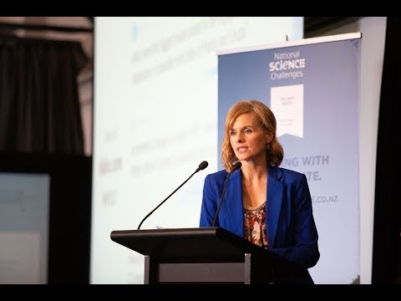

5.2. Conference Panel by the Deep South Challenge (2019) - Changing with our climate
Chaired by acclaimed journalist Mihi Forbes, currently anchoring The Hui, and exploring the question of what hapū and iwi can teach the rest of the New Zealand about changing with our climate.
With panellists:
Aroha Spinks, Massey University
Matapura Ellison, Kāti Huirapa Rūnaka ki Puketeraki
Melanie Mark-Shadbolt, Ministry for the Environment
Ngarimu Blair, Ngāti Whatua Orakei
Sandy Morrison, University of Waikato
Shaun Awatere, Manaaki Whenua Landcare Research
1h
https://youtu.be/6Q6qP647A6U (12/05/2020)

Slide 39
5.3. Climate resilient Māori land - Deep South Challenge project update (2018):
Recent flooding on the East Coast has been a timely reminder about the threat of erosion, which is projected to worsen in our changing climate. In this seminar, researcher Shaun Awatere (Manaaki Whenua) will speak about his Vision Mātauranga project on economic modelling and native afforestation on the East Coast.
Māori within the Waiapu catchment on the East Coast have long-term interests in the land they own and manage. Māori are also heavily invested in primary industries. Projected climate change impacts put these interests at risk.
To help landowners reduce the risks of increased erosion under climate change, and to maximise their revenue, this project – which has only recently concluded – used kaupapa Māori, bio-physical and economic assessment tools to understand and evaluate different land-use decisions.
This research project was a partnership between Manaaki Whenua Landcare Research, SCION and He Oranga mō ngā Uri Tuku Iho Trust.
https://youtu.be/pnxnnysCadA (14.05.2020) Please start at 7.10min in.
1h

Slide 40
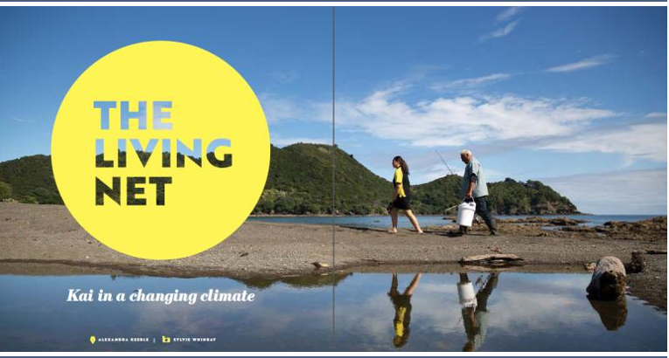

5.4. Deep South Challenge Research: The Living Net – Kai in a Changing Climate
Abstract from the article:
“Kimiora’s vision for place-based learning, for whānau-run orchards, and for the local economy, is that it all might operate like a marae, where everyone has a role and can play to their strengths. “The kids feel comfortable on the marae,” he says. Everyone has a place and knows what to do. And there’s so much to learn here – from environmental management, communications technology and climate science to the fully integrated mātauranga practiced by gardeners and fisher people on the coast.”
The full Deep South Challenge article can be found here:
https://www.deepsouthchallenge.co.nz/news-updates/living-net-kai-changing-climate

Slide 41
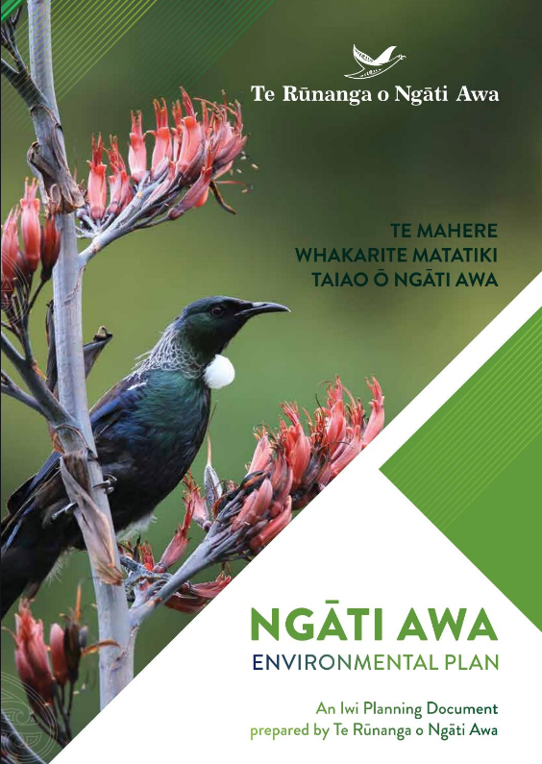
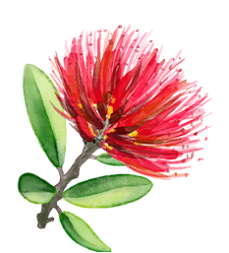

5.5. Iwi/Hapū management plans, including environmental plans
A Hapū/Iwi Resource Management Plan (HIMP) is a document developed and approved by hapū and/or iwi.
These Plans describe resource management issues of importance to them as tangata whenua.
HIMP planning documents recognised by an iwi authority provide a mechanism in which tāngata whenua interests can be considered in Council processes. There are specific legislative requirements which place a duty on Council staff to take these plans into account. In practice, local authorities must balance a number of competing interests, including hapū/iwi plans.
Some hapū/iwi also have environmental plans that state the values of the hapū/iwi in question in regard to natural resource and environmental management in their rohe.
A list of hapū/iwi management plans listed with the BOPRC can be accessed here:
https://www.boprc.govt.nz/your-council/plans-and-policies/plans/hapuiwi-resource-management-plans/

Slide 42

Module 2 survey https://survey.alchemer.com/s3/6035984/Module-2-The-need-to-act-now-public-survey

Slide 43
Next, in Module 3, we will be taking a closer look at the role and responsibilities of Council and Local Government in responding to climate change and get familiar with Council’s own Climate Change Project

