Slide 1
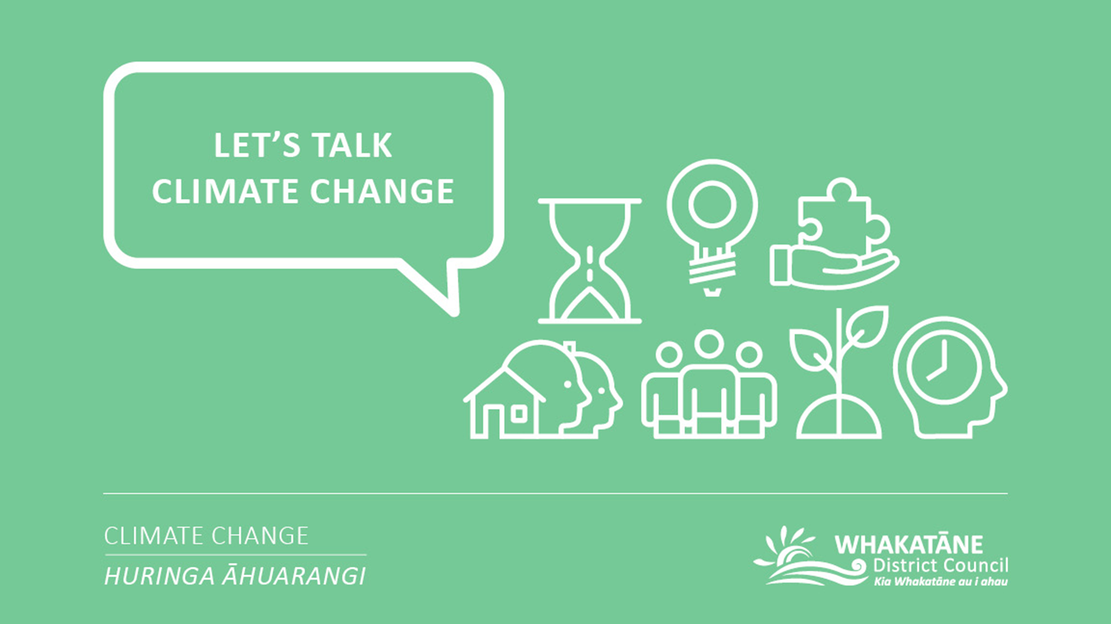
E-LEARNING

Slide 2

Whakatauki
Manaaki whenua, manaaki tangata, haere whakamua
Care for the land, care for the people, Go forward

Slide 3
Disclaimer:​
The information included in this e-learning hub has been compiled by the Whakatāne District Council to help us and our community on a journey of learning and development. The Council does not own and is not the authors of most of the content included in this hub. The Council has compiled content that we felt to be relevant, engaging and wherever possible to provide a local context. Further information regarding Council’s Climate Change Principles, our Climate Change project or our current engagement opportunities can we found on our project page:​
https://www.whakatane.govt.nz/climate-change

Slide 4
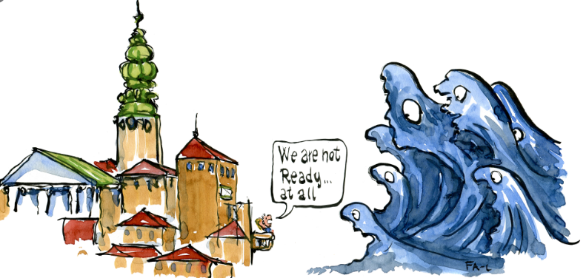
Module 3: Our role and responsibilities
This module includes:
1. The role of Council and Local Government
  1.1. Statutory responsibilities
  1.2. Policy Statements
  1.3 Bay of Plenty Regional Natural Resources Plan
  1.4. Whakatāne District Plan
  1.5. Mitigation and local government
  1.6. Adaptation and local government
2. Whakatāne District Council’s Climate Change Project
2.1. Overview of the Climate Change Project
2.2. Toitū Envirocare
2.3. Energy audit and energy management programme
2.4. The Whakatāne District’s Carbon Footprint
2.5. Council’s Climate Change Project Team
2.6. Climate Change engagement
2.7. Council’s Climate Change Principles
2.8. Council’s Climate Change Strategy and Action Plans
  2.9. Advocacy and collaboration
  2.10. Success stories – celebrating our wins
3. Work underway by others
3.1. Bay of Plenty Regional Council
3.2. Fonterra
3.3. Zespri
3.4. Oji Fibre Solutions
3.5. Te Rūnanga o Ngāti Awa
Learning statement for this module
What is Council’s role when it comes to climate change and what are we doing about it already?

Slide 5
1.1. Statutory responsibilities
1. The role of Council and Local Government
Local Government Act:
“Regard” must be had to:
  Prudent stewardship of resources
  Planning effectively for future management of assets
  Taking a sustainable development approach
  Maintaining and enhancing the quality of the environment
  The reasonably foreseeable needs of future generations
Resource Management Act:
“Regard” must be had to:
  Maintenance and enhancement of the quality of the environment, and to the effects of climate change
  NZ Coastal Policy Statement: “ensure” that coastal hazard risks are managed and identified for a period of at least 100 years, taking account of climate change, and applying a precautionary approach
More information:
https://www.solgm.org.nz/Attachment?Action=Download&Attachment_id=1943

Slide 6
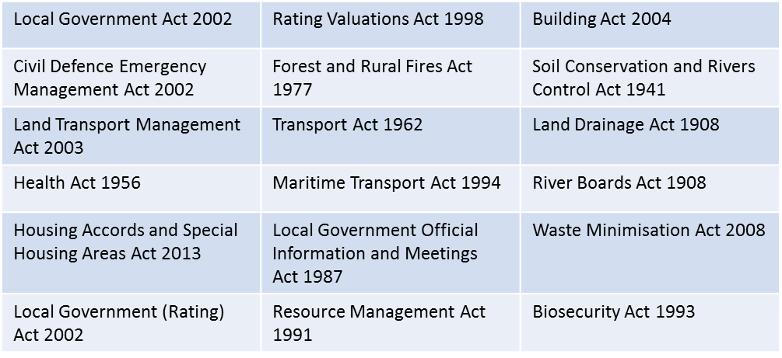
The below legislation sets out roles and responsibilities for local government which may be affected by climate change (even if climate change is not expressly mentioned).
The LGNZ report ‘How Climate Change Affects Local Government’ highlights how responsibilities may be impacted by a changing climate, and identifies opportunities to address climate change. The report assesses legislative responsibilities and roles that are not required under the law.
The next slide includes a table from this report, noting where changes in the climate have been assessed as having a “definite” impact on local government roles and responsibilities. The information regarding LGOIMA requests (last row) comes from the LGNZ report ‘Natural Hazards Information on LIMs.’
“The pervasive impact of climate change on local government’s roles and responsibilities underscores the importance of sharing and collaboration, and reinforces the need for taking a whole of systems approach in responding to climate change”
For the full report:
https://www.lgnz.co.nz/assets/Uploads/f86bfef615/44476-LGNZ-How-climate-change-affects-local-government2.pdf

Slide 7
Local government roles and responsibilities in the context of climate change (from LGNZ)
Role | Mitigation | Adaptation | Why is this role important in the context of climate change?
Decision-making and the purpose of local government (Local Government Act) | √ | √ | Allows impacts on the needs of current and future generations to be considered in decision-making. Longer-term, scenario based risk management decision-making will be needed.
Provision of services (Local Government Act) |  | √ | Provides for consideration of the impacts of events (storms, flood, fire, storm surge) or slow onset changes in sea level rise on services provided by councils such as flood protection, water supply, waste services, transport networks, community facilities and amenities.
Setting policies for resource use (Resource Management Act and subordinate policy statements) | √ | √ | Provides an opportunity to set policies for resource use that help to mitigate and adapt to climate change. Council decision-making must have particular regard to the effects of climate change, the efficient use of energy and benefits of renewable energy.
Preparing the district plan (Resource Management Act and subordinate policy statements) | √ | √ | Allows operational rules and spatial plans to consider the impacts of climate change (adaptation) and to manage emissions (mitigation) while being consistent with regional policy statements.
Preparing the regional land transport plan (Land Management Transport Act) | √ | √ | Provides an opportunity to promote lower carbon and energy efficient transport options such as walking, cycling and public transport, and must take into account impacts of climate change on existing transport corridors (particularly coastal).
Developing waste management and minimisation plans (Waste Minimisation Act) | √ |  | Opportunity to reduce landfill emissions through the promotion of waste minimisation eg waste avoidance, recycling, composting and landfill gas collection.
Acting as consent authority (Resource Management Act) | √ |  | Councils can manage certain activities that exacerbate the effects of climate change or impose conditions to mitigate effects.
Prepare and implement civil defence and emergency management plans (Civil Defence Emergency Management Act) |  | √ | Councils must understand, prepare for and respond to natural hazards that may be more frequent and severe because of climate change, placing additional management and financial burden on councils.
Consenting new development (Building Act) |  | √ | Councils will need to consider greater risk of natural hazards when issuing building consents. Councils may also be liable for developments that increase exposure to natural hazards.
Issue Land Information Memoranda (LIMs) on request under the Local Government Official Information and Meetings Act 1987 (LGOIMA). |  | √ | LIMs must identify information that is “known” to the territorial authority regarding any special feature or characteristic of the land concerned that is not included in a district plan. This may include, amongst other things, potential erosion, avulsion, falling debris, subsidence, slippage, alluvion, or inundation. There is growing awareness regarding climate change.

Slide 8
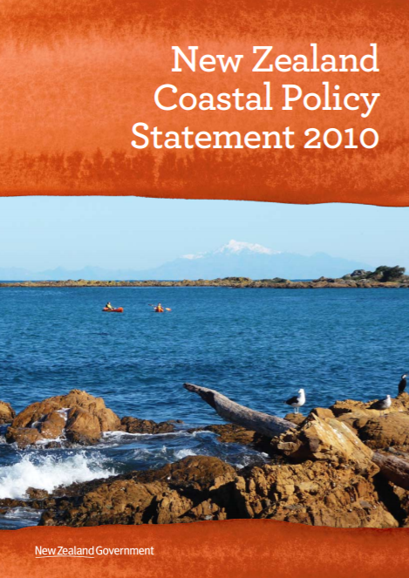
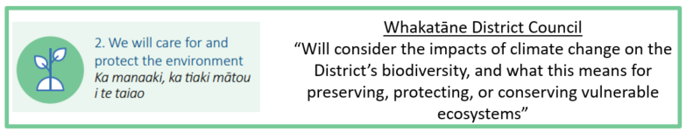
The New Zealand Coastal Policy Statement (NZCPS) guides local authorities in their day to day management of the coastal environment. It notes that the coastal environment has characteristics, qualities and uses that mean there are particular challenges in promoting sustainable management. This includes recognition that activities in the coastal environment are susceptible to the effects of natural hazards such as coastal erosion and tsunami, and those associated with climate change.
Objective 4: To maintain and enhance the public open space qualities and recreation opportunities of the coastal environment by: … recognising the potential for coastal processes, including those likely to be affected by climate change….
Objective 5: To ensure that coastal hazard risks taking account of climate change, are managed by: locating new development away from areas prone to such risks; considering responses, including managed retreat, for existing development in this situation; and protecting or restoring natural defences to coastal hazards.
A number of policies in the NZCPS specifically mention climate change:
Policy 3: Precautionary approach
Policy 4: Integration
Policy 10: Reclamation and de-reclamation
Policy 18: Public open space
Policy 24: Identification of coastal hazards
Policy 27: Strategies for protecting significant existing development from coastal hazard risk
1.2. Policy Statements: New Zealand Coastal Policy Statement
Full document:
https://www.doc.govt.nz/documents/conservation/marine-and-coastal/coastal-management/nz-coastal-policy-statement-2010.pdf

Slide 9
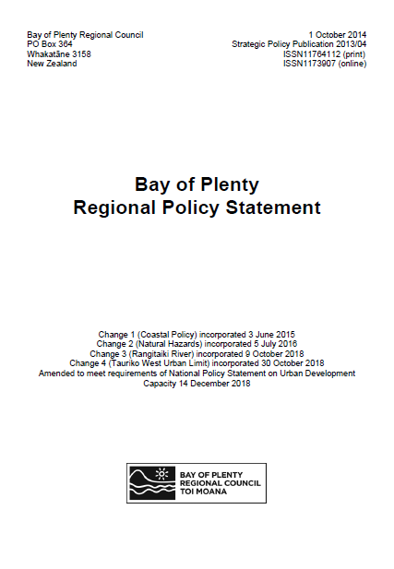
The Regional Policy Statement provides a framework for sustainably managing the region's natural and physical resources. It highlights regionally significant issues with our land, air, fresh and coastal water, infrastructure and biodiversity, including issues of significance to iwi. It sets out what needs to be achieved, and how it will be achieved. It must be given effect to by the region's city and district councils when developing their district plans.
The Statement requires territorial authorities to manage future climate change effects on the environment. Specific sections of relevance are:
Policy IR 2B: Having regard to the likely effects of climate change
Policy NH 11B: Providing for climate change
Method 73: Provide information and guidance on natural hazards (including climate change effects)
Note that the Bay of Plenty Regional Council is currently undertaking work which will update these sections.
1.2. Policy Statements: Regional Policy Statement
More information:
https://www.boprc.govt.nz/your-council/plans-and-policies/policies/regional-policy-statement/

Slide 10

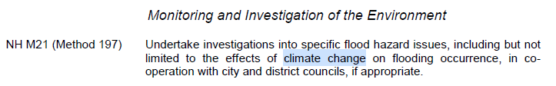
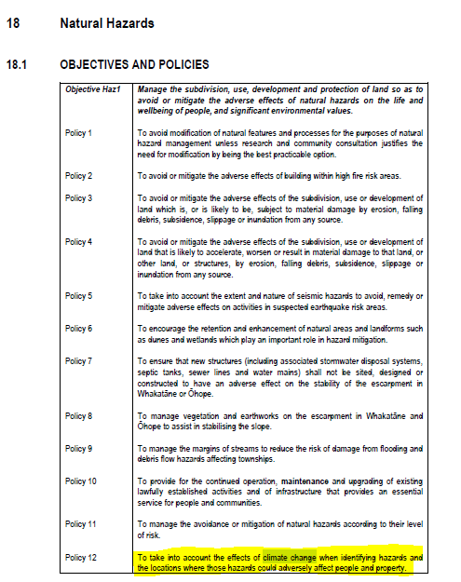
1.3. Bay of Plenty Regional Natural Resources Plan
The purpose of the Regional Natural Resources Plan (RNRP) is to promote the sustainable and integrated management of land and water resources within the Bay of Plenty. To achieve this, the RNRP has policies and methods (which include rules) to address issues of use, development and protection of land resources, geothermal resources and freshwater resources, including the beds and margins of water bodies.
The resources covered by the Regional Natural Resources Plan are:
Soil (land)
Rivers and streams
Lakes
Wetlands
Groundwater
Geothermal
Natural Hazards
Air
Full plan:
https://atlas.boprc.govt.nz/api/v1/edms/document/A3490282/content

Slide 11
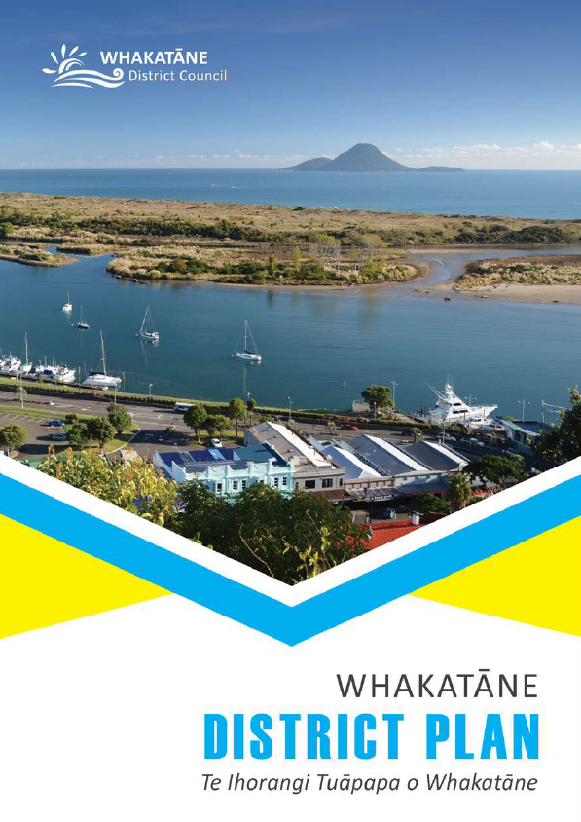
1.3. Whakatāne District Plan
The RMA requires the Council to have a District Plan (DP). The purpose of the DP is to help the Council carry out its responsibilities under the RMA, including controlling of the effects of use, development and protection of land. The purpose of the RMA is to promote the sustainable management of natural and physical resources. Anything that is done under the provisions of the RMA must advance this statutory purpose. Sustainable management is defined in Section 5(2) of the RMA but in general it means managing the use, development, and protection of natural and physical resources in a way, or at a rate, which enables people and communities to provide for their social, economic and cultural well-being and for their health and safety while;
  a. sustaining the potential of natural and physical resources (excluding minerals) to meet the reasonably foreseeable needs of future generations;
  b. safeguarding the life-supporting capacity of air, water, soil and ecosystems; and
  c. avoiding, remedying or mitigating any adverse effects of activities on the environment.
In the ‘Natural Hazards’ chapter of the DP, Objective Haz1 is to: manage the subdivision, use, development and protection of land so as to avoid or mitigate the adverse effects of natural hazards on the life and wellbeing of people, and significant environmental values. Policy 12 under this objective is: to take into account the effects of climate change when identifying hazards and the locations where those hazards could adversely affect people and property.
Section 3.7.25.1(vii) notes that, in relation to inundation from any source, the Council shall have regard to the potential impact of climate change.
More information:
https://www.whakatane.govt.nz/documents/council-plans/operative-district-plan-2017

Slide 12
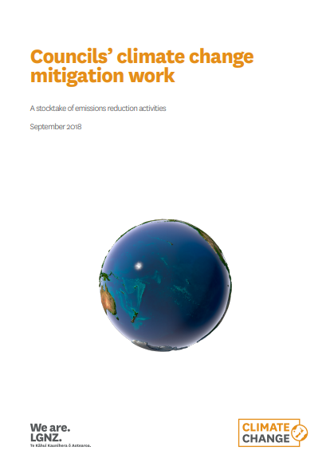
1.3. Mitigation and local government
In 2018, LGNZ produced a stocktake of mitigation work underway in councils across New Zealand. The stocktake is available in the report ‘Councils’ climate change mitigation work.’
To inform the report, councils were asked to outline the activities that they have underway, or intend to undertake, to reduce emissions within their organisations and/or communities.
The report demonstrate that significant work is underway across the country. The range of actions and strategies that councils have adopted to contribute to emissions reductions is broad and varied. Some of the actions and strategies have a strong sustainability focus as opposed to having climate change mitigation at their core, but will likely contribute directly or indirectly to emissions reductions.
Full report:
https://www.lgnz.co.nz/assets/Uploads/f4cafb5ec0/46628-LGNZ-Summary-of-Emission-Reduction-7-Proof-FINAL.pdf

Slide 13
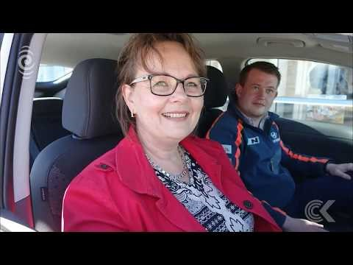


A couple of examples of mitigation initiatives…
Video: 100 fully electric vehicles will be available for residents to hire as part of a Christchurch City Council led initiative (Yoogo).
3min
Video: Waste management intends to convert the majority of their fleet from conventional fossil fuels to plug-in electric.
2min
More information about Yoogo:
https://www.youtube.com/watch?v=QkjkpnhO_cI

Slide 14
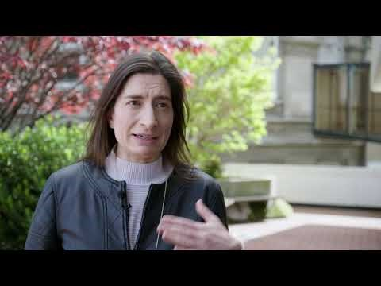

1.4. Adaptation and local government
Under the Resource Management Act 1991, local government is required to consider the effects of a changing climate on communities. It is also required to incorporate climate change into existing frameworks, plans, projects and standard decision-making procedures. A climate change perspective is now integrated into activities such as flood management, water resources, planning, building regulations and transport.
This video from the Deep South Challenge provides a Dunedin City Council perspective on climate-adaptive communities. In 2015, South Dunedin was hit by serious flooding. Not only did the community recover, but it has been learning from the increasingly common experience and working with the Dunedin City Council to build resilience and adapt to climate change.
https://youtu.be/Em4ekQpppXM
4min
More information:
https://www.deepsouthchallenge.co.nz/projects/climate-adaptation-vulnerability-and-community-well-being

Slide 15
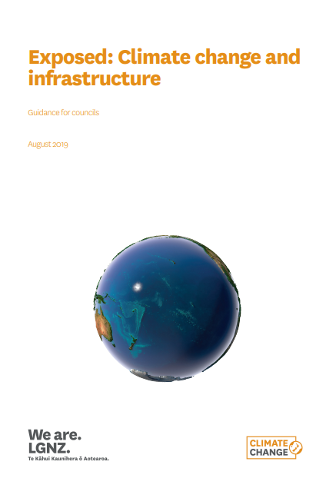
1.4. Adaptation and local government
The LGNZ report Exposed: Climate Change and Infrastructure is designed to provide councils with support, and a consistent approach, for regularly assessing the exposure of their infrastructure to sea level rise and inland flood risk.
The report includes a section of key questions for Elected Members (Section 6), designed to ‘support elected members to prime and test council staff, constituents and stakeholders, to allow them to engage in the most effective long term planning and infrastructure investment decision-making.’
Australia’s National Climate Change Adaptation Research Facility has published a series of briefing notes designed for specific sectors/decision makers. These provide a brief introduction to the key issues, climate impacts and adaptation options for that sector. A briefing note for elected members is available here.

Slide 16
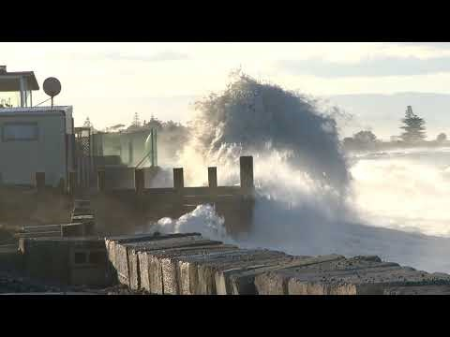
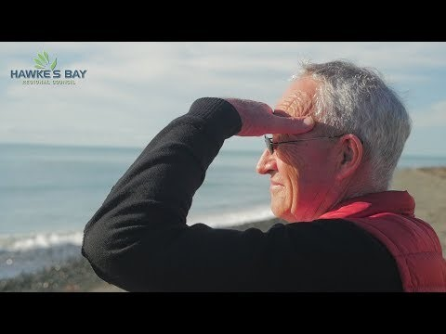
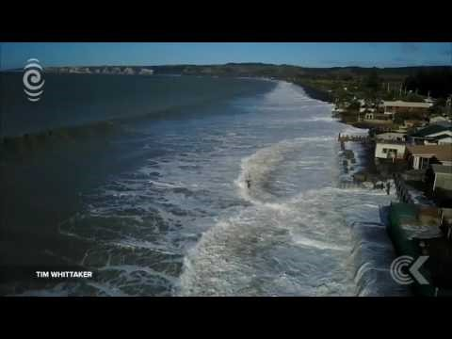
Adaptation case study – Hawkes Bay Clifton to Tangoio 2120 Coastal Hazards Strategy
Hawke’s Bay Regional Council, Hastings District Council and Napier City Council are working together to develop a strategy for managing, or mitigating, coastal hazard risks along the Hawke’s Bay shoreline from Tangoio to Clifton. The Strategy was initiated in 2014 with the establishment of a Technical Advisory Group and a Joint Committee formed representatives from the Councils, MaungaharuruTangitu Trust, Mana Ahuriri Incorporated and He Toa Takitini.
The Ministry for the Environment and Hawke’s Bay Regional Council have developed a case study investigating challenges with the implementation of the Strategy. This is being reviewed to see what national-level changes (legislative changes, funding models etc.) may be needed to assist councils and communities to respond to climate change impacts.
Tonkin & Taylor discussing the Clifton to Tangoio 2120 Coastal Hazards Strategy (40 sec) | Hawkes Bay Regional Councillor discusses the Strategy development (2min) | Hawkes Bay community discuss erosion and frustration with inaction from council (7 min)
More about the Strategy: https://www.hbcoast.co.nz/
More about the case study: https://www.mfe.govt.nz/publications/climate-change/challenges-implementing-clifton-tangoio-coastal-hazards-strategy-2120

Slide 17
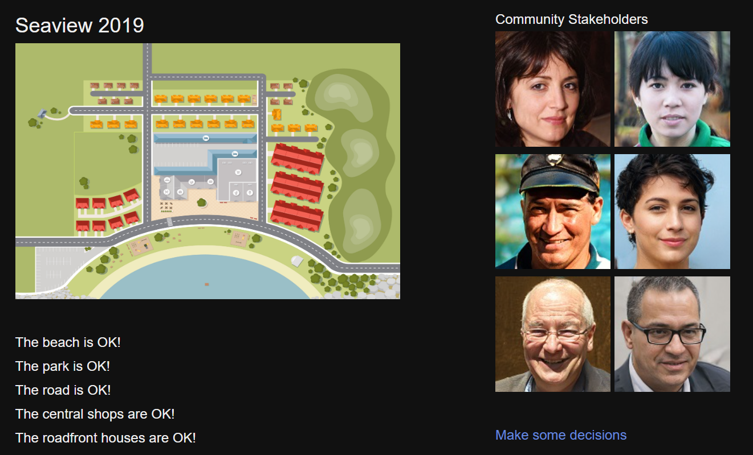
Adaptive Futures: A serious game for thinking about how coastal communities adapt to climate change
Adaptive Futures is a 'serious game' designed to introduce players to community-level decision-making and climate change adaptation. The research used to produce the game was conducted jointly through NIWA Taihoro Nukurangi and Manaaki Whenua Landcare Research, and funded by the Natural Hazards Research Platform.
The objective of the game is to protect the ‘Seaview’ community from the adverse effects of climate change. Doing this will require the player to take actions to adapt to these effects, and their ability to take action depends on support from the community.
Three easy steps to play:
Fill out the pre-game survey
Play the game
Provide feedback

Slide 18
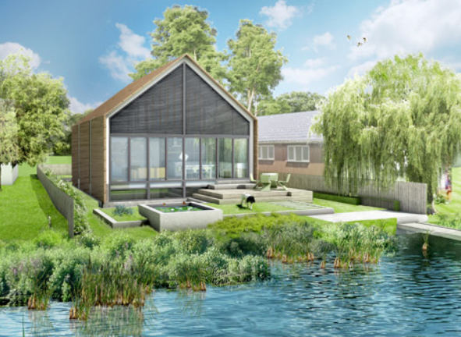
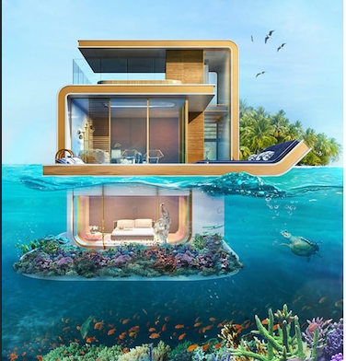
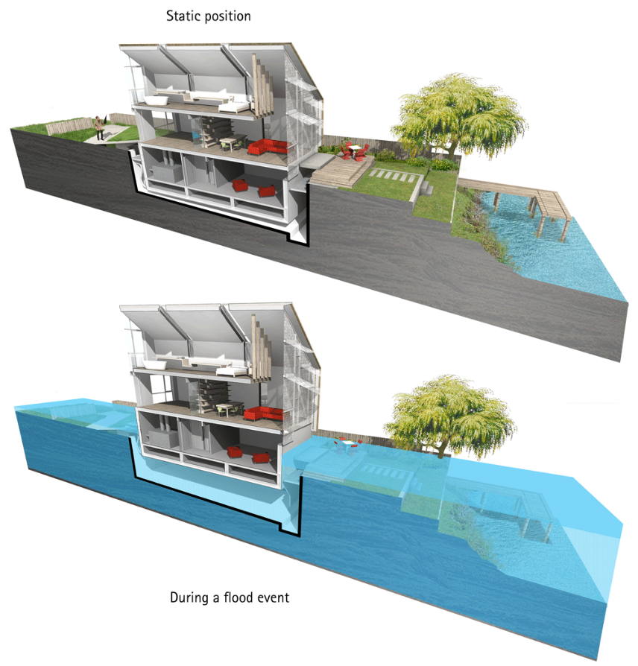
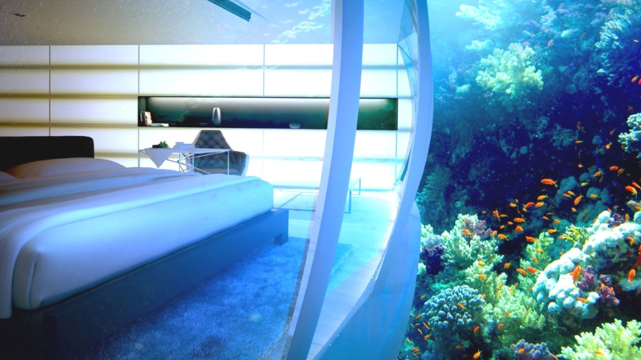
Examples of adaptive infrastructure
London
Dubai

Slide 19
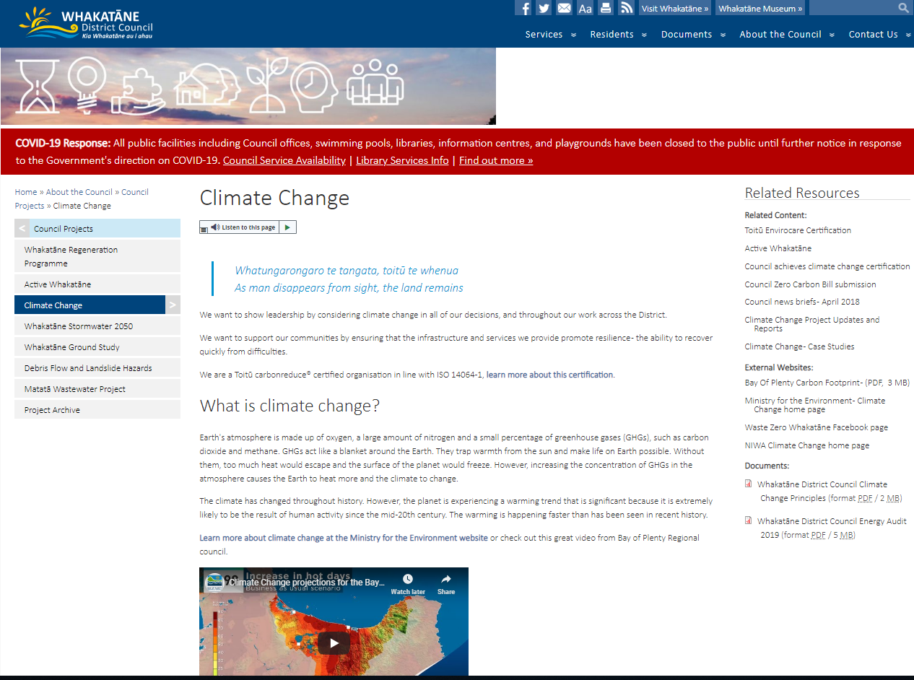


2. Council’s climate change project
2.1. Overview of Council’s Climate Change Project
In response to signing the NZ Local Government Leaders Climate Change Declaration in 2017, Council launched a Climate Change Project in 2018.
This project has it’s own page on Council’s website.
Discover it here: https://www.whakatane.govt.nz/climate-change
On the website you will find:
The most up to date information on what Council is doing in the climate change space, including any engagement underway.
Useful links and reports.
Case studies celebrating our victories as we move along on this journey.

Slide 20
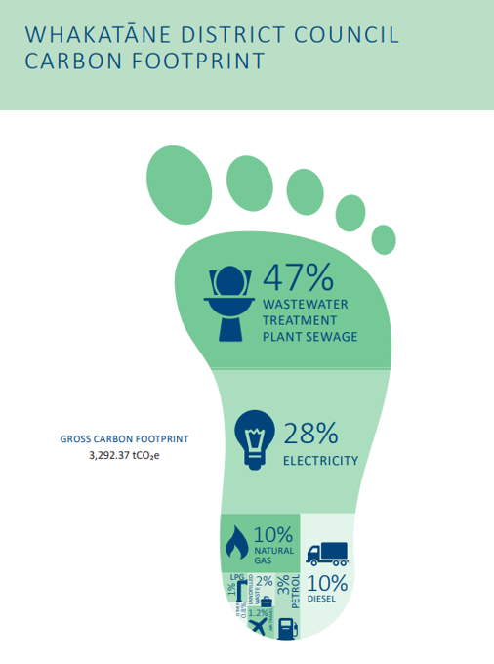



2.2. Toitū Envirocare
The Council is a Toitū carbonreduce®️ certified organisation in line with ISO 14064-1. To gain certification, we measured and assessed greenhouse gas emissions for 2017-18. This provided twelve months of data on which to base an Emissions Management and Reduction Plan.
Our footprint for 2017/18 was 3,292 tonnes of carbon dioxide equivalent (tCO2e).
A number of projects are being implemented to achieve a reduction in our greenhouse gas emissions, and the Toitū carbonreduce®️ audit process for our emissions in 2018-19 is being finalised.
Council’s Toitū Envirocare Certification
https://www.toitu.co.nz/__data/assets/pdf_file/0014/211181/Disclosure_1718_WDC_CM_Org.pdf
Whakatāne District Council’s Carbon Footprint for 2017/18
Find out more about Toitu: https://www.toitu.co.nz/home

Slide 21
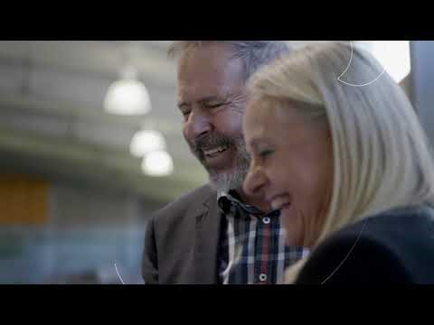
Some more about Toitū:
2min
https://www.youtube.com/watch?v=TzxgEdUFwTA (28/05/2020)
Find out more about Toitu:
https://www.toitu.co.nz/home

Slide 22
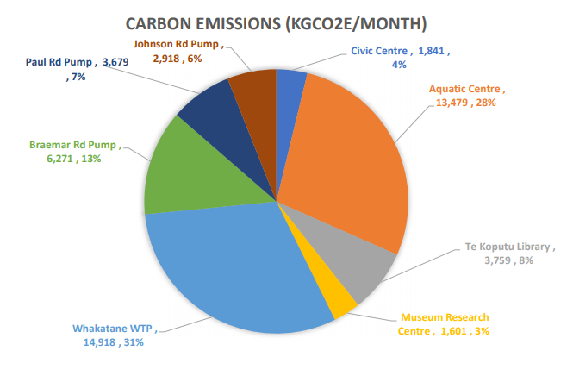




2.3. Council’s energy audit and energy management programme
In June 2018, an energy audit was undertaken across the Council’s 182 electricity and natural gas accounts.
One of the primary drivers for commissioning the audit was to understand how the Council’s carbon emissions are influenced by energy use and what opportunities exist to reduce carbon emissions that contribute to climate change.
The energy audit report sets out a range of recommendations. Work is underway to implement or further investigate many of these through an energy management programme.
Council’s Energy audit report, 2017/18
https://www.whakatane.govt.nz/sites/www.whakatane.govt.nz/files/documents/wdc_type_2_energy_audit_report_public_191119_-issued.pdf
Carbon emissions from energy consumption for the month of April 2020
for the eight monitored Council facilities

Slide 23
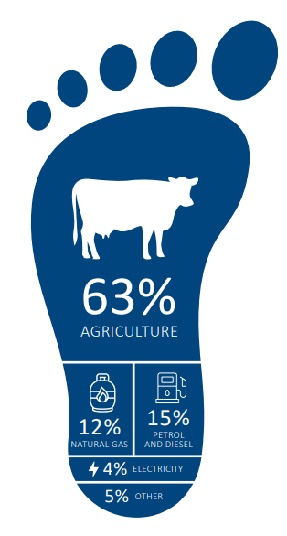

2.4. The Whakatāne District’s Carbon Footprint
The District footprint to the right shows the largest sources of carbon emissions for the Whakatāne District.
By far the largest emitter of greenhouse gas in our District is the agricultural sector (63%). These emissions are generated mainly by dairy and beef farming.
The next largest emissions source is natural gas (12%), followed by diesel (9%) and petrol (6%). The majority of natural gas emissions are generated by commercial and industrial processes, whereas the diesel and petrol are primarily used by road transportation (including both private and industry use).
These figures re-enforce the rural nature of the district, highlighting the travel distances between urban centres.
Read the full BOP Community Carbon Footprint, 2015/16
(including the Whakatāne District’s, p.43 onwards)
https://www.boprc.govt.nz/media/718089/bay-of-plenty-community-carbon-footprint-2015_16_-final-results.pdf

Slide 24
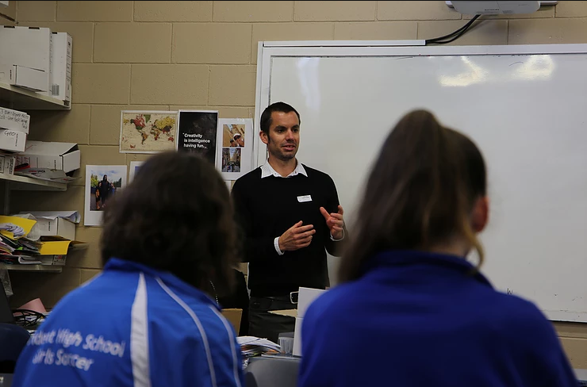
2.5. Council’s Climate Change Project Team
Council has an interdisciplinary Climate Change Project Team consisting of staff across the organisation. The team meets regularly to progress workstreams under the Climate Change Project. The current project team includes:
Strategic Coordinator – Climate Change
Team Leader – Strategy and Asset Management
Manager – Properties and Facilities Assets
GIS Analyst
Manager Strategy and Community Development
Strategic Policy Analyst
Manager Building and Environmental Services
Communications Support, Strategic Projects
Project Engineer - Three Waters
Reserve Planner, Open Spaces Operations
Community Engagement Advisor
Team Leader Three Waters Asset Management and Planning
Manager Resource Consents
Manager Policy, Planning and Consents compliance
Manager Solid Waste
Team Leader Procurement and Administration

Slide 25
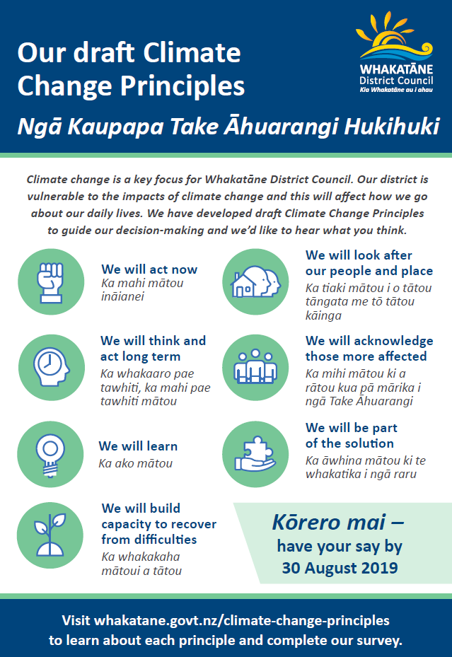
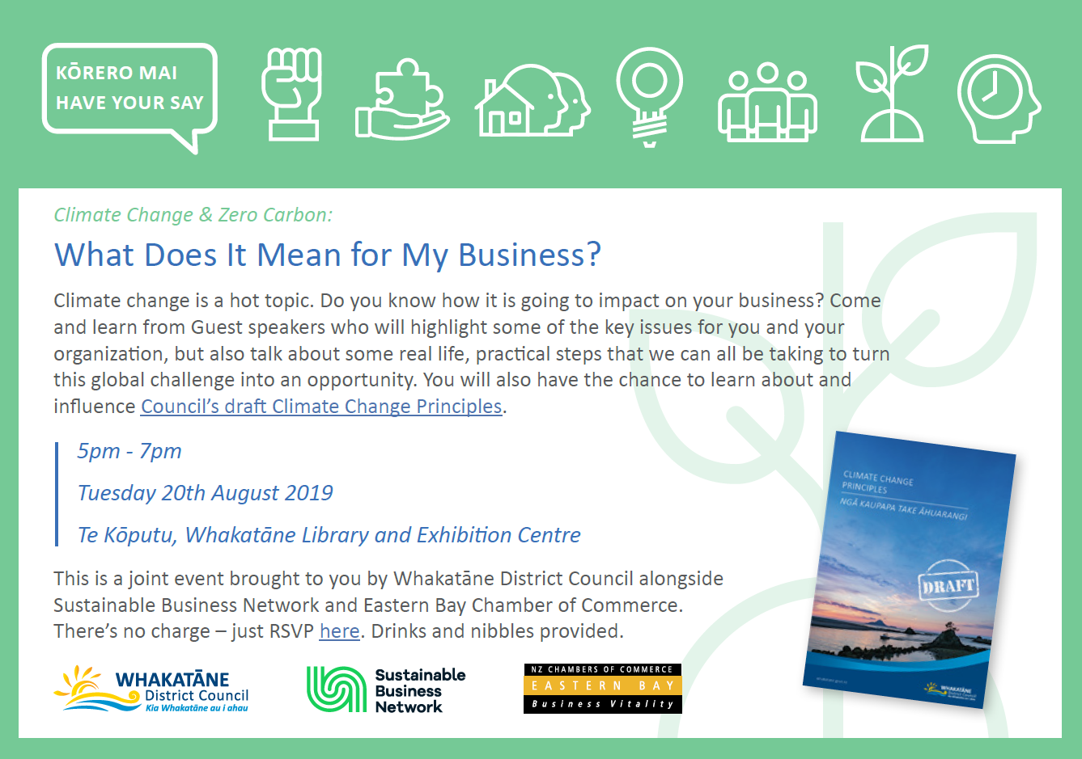
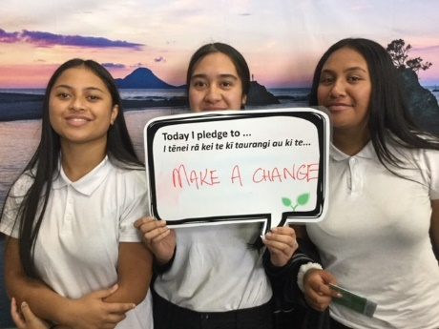
2.6. Climate change engagement
Council has engaged on its Climate Change Project a lot since establishment in 2018.
Feedback and comments about climate change have been received through:
Organising media campaigns,
School workshops,
A fully online climate change survey,
Organising and participating in engagement events like:
  The Business and Leisure Show 2019,
  Sustainable Backyards 2019 and 2020,
  Movie screenings,
  Drop-in sessions across the District,
  Key stakeholder engagement
  (like “Business after five” and Putake Taiao – course presentation)
We’ve received feedback from over 1,200 people

Slide 26
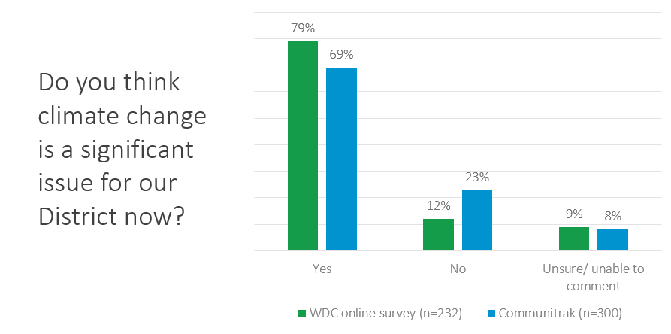
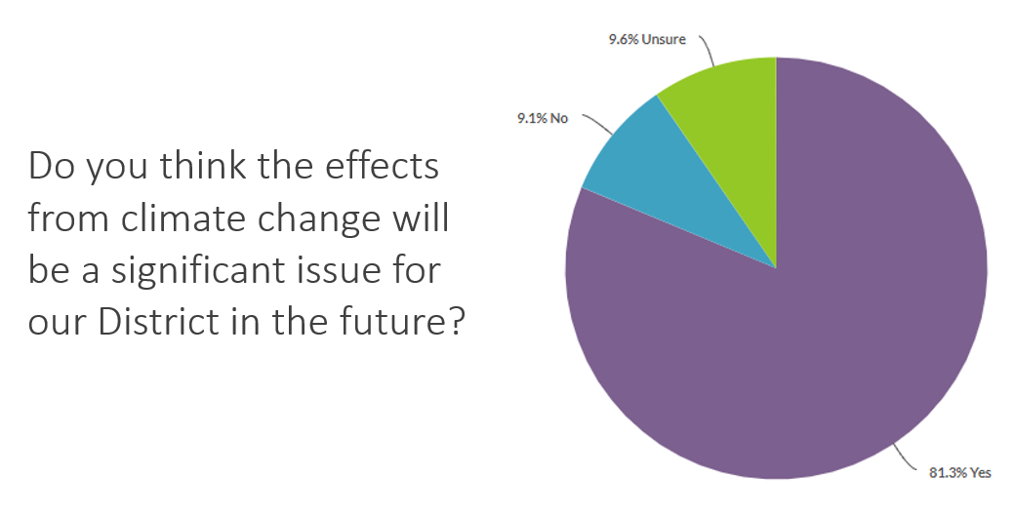
Through all the feedback received the message is clear – residents think climate change presents a significant issue for our District

Slide 27
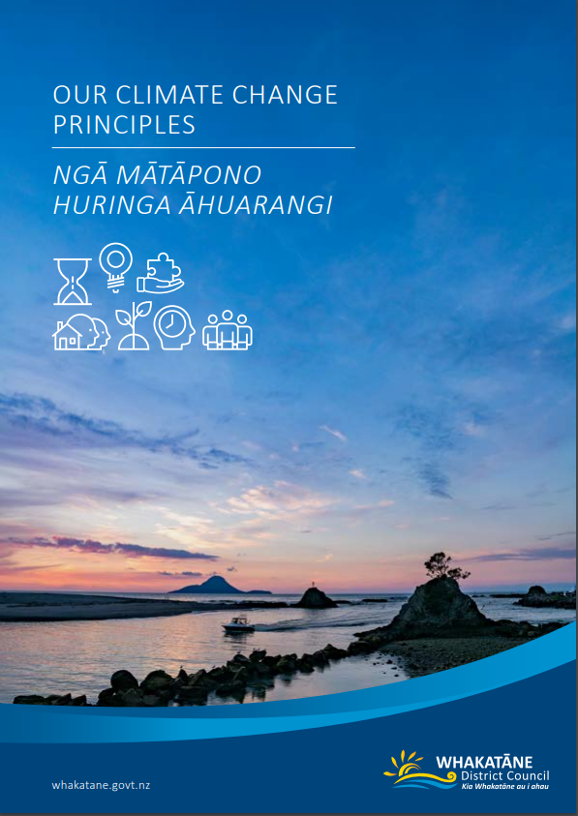
2.7. Council’s Climate Change Principles
Council adopted a set of seven Climate Change Principles in September 2019.
To align with the national response, these Principles are based on those set out in The Local Government New Zealand Leader’s Climate Change Declaration.
Council’s Climate Change Principles help integrate work already underway and guide future projects and decisions.
Extensive community engagement was undertaken on the Principles, with more than 800 people directly involved in engagement initiatives and over 1,100 climate change related engagement points received.
Youth across the District were especially involved in the development in these Principles and making sure they convey an empowering message.
You can find the full Climate Change Principles document here:
https://www.whakatane.govt.nz/sites/www.whakatane.govt.nz/files/documents/climate_change_principles_-_final.pdf

Slide 28
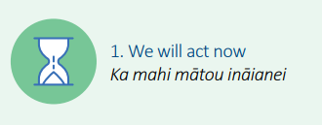
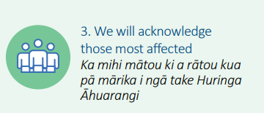
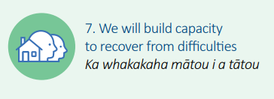
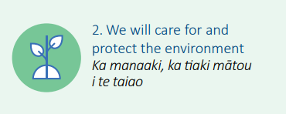
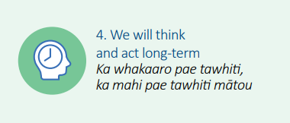
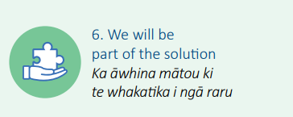
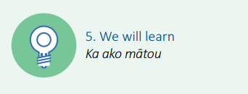
Council’s seven Climate Change Principles
You can find the full Climate Change Principles document here:
https://www.whakatane.govt.nz/sites/www.whakatane.govt.nz/files/documents/climate_change_principles_-_final.pdf

Slide 29
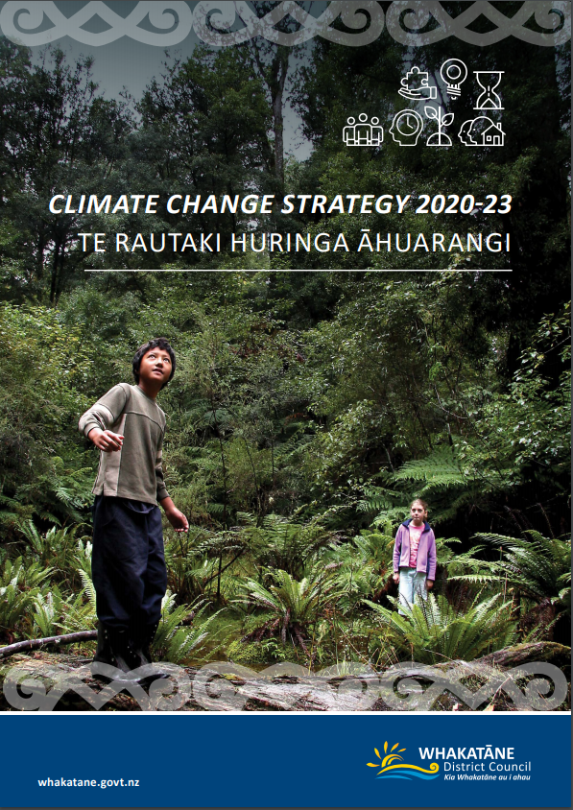
2.8 Council’s Climate Change Strategy and Action Plans
The main piece of work the Council’s climate change project has been progressing in 2020 has been the development and implementation of a climate change strategy and action plans.
The purpose of the climate change strategy is to:
Integrate and coordinate climate change-related work throughout different areas of Council
Raise awareness of climate change and its impacts in the community
Show leadership on the issue of climate change
Provide a starting-point for community conversations
Provide a framework for the prioritisation and commencement of action.
The strategy situates the Council’s approach in the international, national, and regional context of climate change, and notes alignment with the Council’s Climate Change Principles.
Throughout the consultation process, the community once again voiced their desire to see Council show leadership when it comes to responding to climate change.
Feedback from the community then shaped the final versions of these documents, adopted in late September 2020.
The adopted climate change strategy and action plans are publicly available on Council’s climate change page:
https://www.whakatane.govt.nz/climate-change.

Slide 30
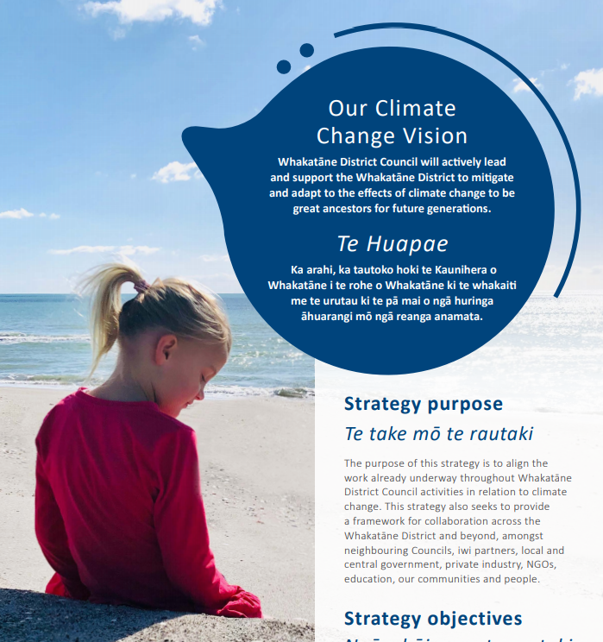
Strategy vision
The full climate change strategy can be viewed here:
https://www.whakatane.govt.nz/sites/www.whakatane.govt.nz/files/documents/climate-change-strategy-2020-final.pdf

Slide 31
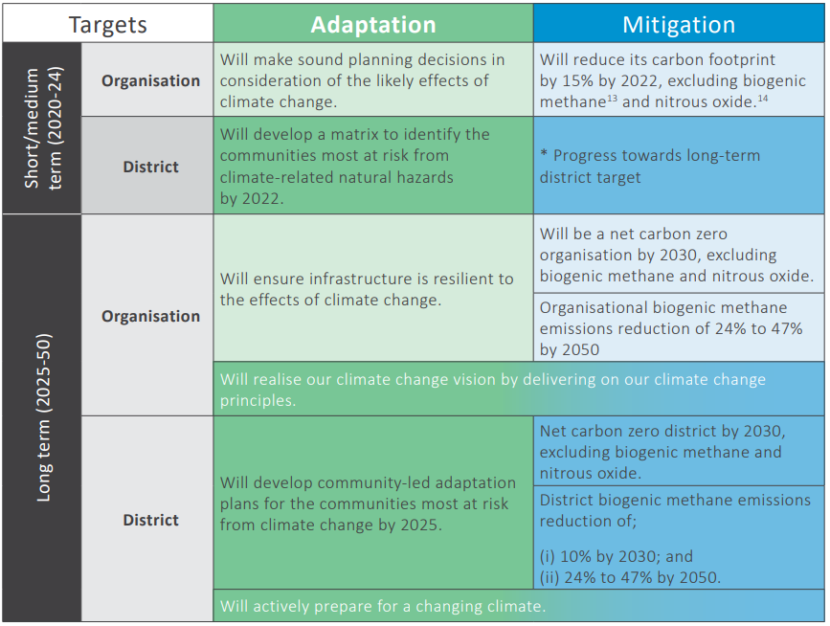
Strategy targets
The Council’s climate change strategy sets some quite ambitious targets for both the Council and the District as a whole.
The most important ones include both the Council and the District being net Zero Carbon by 2030.
On the adaptation side, our long-term target include developing community-led adaptation plans for the communities most at risk from climate change by 2025.
Progressing towards these targets will require important and sometimes difficult conversations with the community, particularly around how we need to change and adapt to the reality of climate change.
The full climate change strategy can be viewed here:
https://www.whakatane.govt.nz/sites/www.whakatane.govt.nz/files/documents/climate-change-strategy-2020-final.pdf

Slide 32
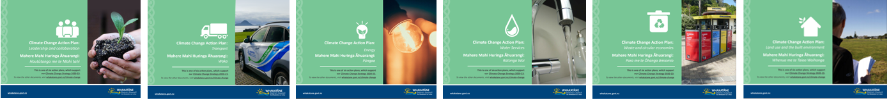
Climate Change Action Plans
The climate change action plans list the steps we will need to take to reach the targets set out in the strategy.
Our actions have been identified through the Council’s Climate Change Project, energy management programme, Toitu Carbonreduce certification, and feedback from the community.
The action plans are centred around six key focus areas:
Leadership and collaboration
Transport
Energy
Water Services
Waste and circular economies
Land use and the built environment
The adopted climate change action plans are publicly available on Council’s climate change page:
https://www.whakatane.govt.nz/climate-change.

Slide 33
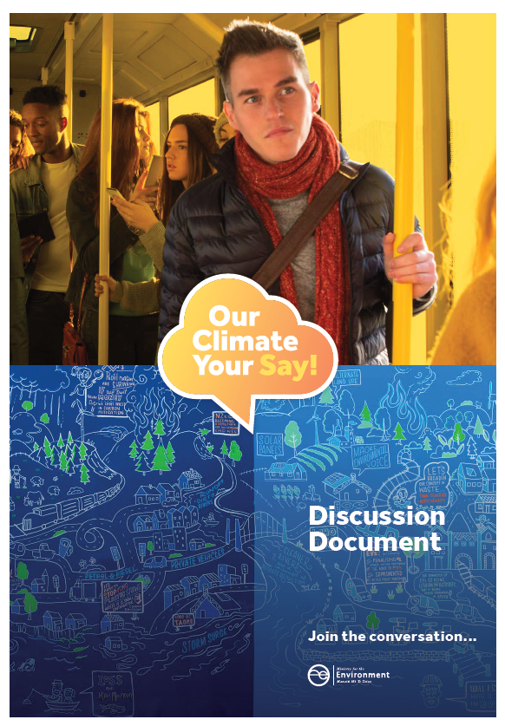
2.9. Collaboration and advocacy
Climate action is the responsibility of all levels of society, and an effective response requires an all-of-community effort. The Council has been involved in a range of collaborative initiatives, including:
Regular meetings with climate change staff at neighbouring councils
An informal national climate change network for council staff
Contributing to climate change-related academic research through interviews
Attending (and in some cases presenting at) national climate change conferences
Engagement activities including Sustainable Backyards and Youth Jam
A key focus of the Climate Change Project is to continue collaborating and sharing throughout the Council’s climate change journey.
The Council has made submissions advocating for climate change action to processes including:
The Zero Carbon Bill
Bay of Plenty Regional Council Annual Plan 2019/20
Government Policy Statement on Land Transport 2018
LGNZ Draft Local Government Position on Climate Change Mitigation
Productivity Commission Low-Emissions Economy Draft Report

Slide 34
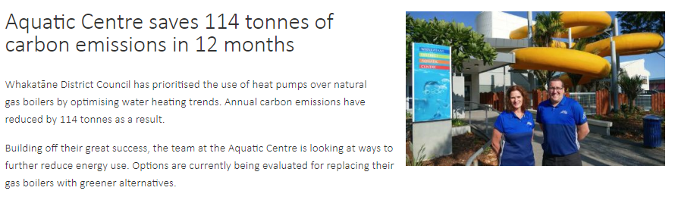
2.10. Success stories – celebrating our wins
Council has several work streams underway within the scope of its’ Climate Change Project.
It is important to take the time to celebrate our wins and highlight the steps taken in the right direction.
The Whakatane Aquatic Centre case study is first in a series of many more to come.
Read the full case study here: https://www.whakatane.govt.nz/sites/www.whakatane.govt.nz/files/documents/energy_management_programme_aquatic_centre_case_study.pdf
The story did also get picked up by the media:
https://www.stuff.co.nz/national/politics/local-democracy-reporting/119822031/whakatne-district-council-reduces-emissions-saves-thousands

Slide 35

3. Work underway by others
Council is not alone when it comes to tackling climate change – our neighbours are out there doing some fantastic work.
The following slides provide five great examples:
The Bay of Plenty Regional Council
Fonterra
Zespri
Oji Fibre Solutions
Te Rūnanga o Ngāti Awa

Slide 36
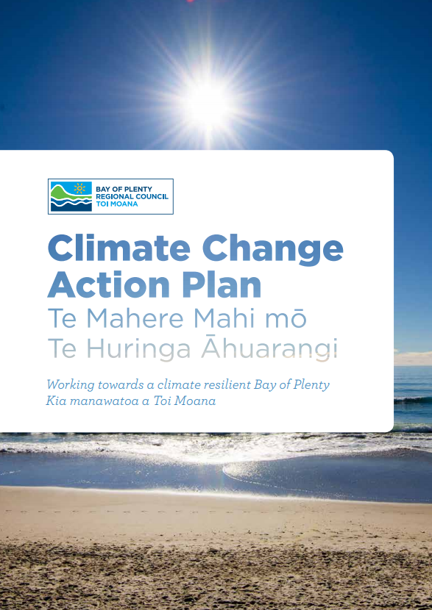

3.1. Bay of Plenty Regional Council
  Visit their climate change page: https://www.boprc.govt.nz/environment/climate-change/
  Check out their Climate Change Action Plan https://atlas.boprc.govt.nz/api/v1/edms/document/A3385266/content
  Bay of Plenty Regional Council has set the internal target to become carbon zero by 2050.

Slide 37
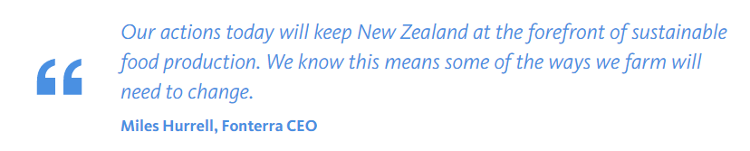

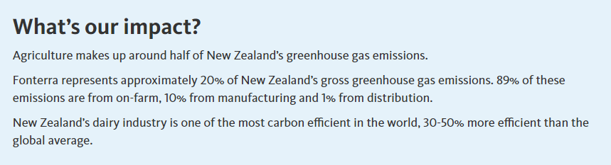

3.2. Fonterra
  Visit their climate change webpage:
  https://www.fonterra.com/nz/en/what-we-stand-for/environment/climate-change.html
  In 2019, Fonterra announced it will be transitioning away from coal. No new coal boilers will be installed and increasing capacity to burn coal is not permitted.

Slide 38
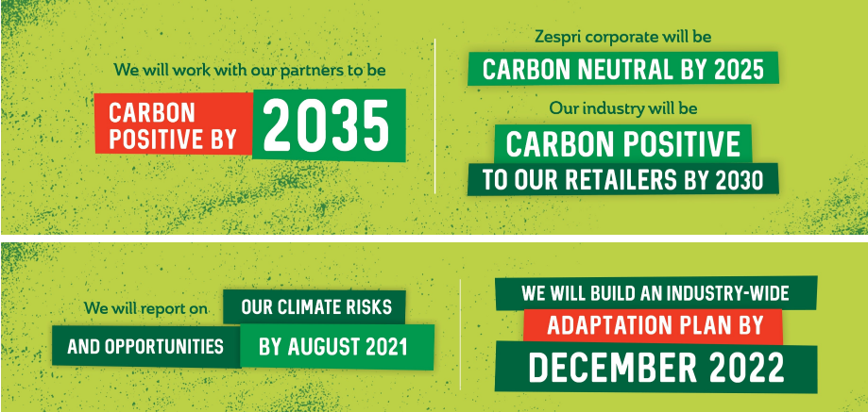



3.3. Zespri
  Visit their sustainability homepage:
  https://www.zespri.com/en-NZ/zespri-sustainability
  Zespri has signed up to the climate leader’s coalition:
  https://www.climateleaderscoalition.org.nz/who/signatories/signatories/zespri
  Zespri has announced it is striving to become carbon positive by 2030.

Slide 39






3.4. Oji Fibre Solutions
Visit their sustainablity webpage:
https://www.ojifs.com/sustainability/
Oji has signed up the Climate Leaders Coalition: https://www.climateleaderscoalition.org.nz/who/signatories/signatories/oji
Case study on the transformation of the Tasman Mill:
https://www.climateleaderscoalition.org.nz/__data/assets/pdf_file/0004/182245/OjiFS-carbon-reduction-case-study_Tasman-Mill.pdf
Tasman Mill is NZ’s largest producer of bio-renewable energy and have recently completely eliminated the use of coal in their production.

Slide 40





3.5. Te Rūnanga o Ngāti Awa
Visit their taiao webpage:
https://www.ngatiawa.iwi.nz/about-te-rununga-o-ngati-awa/depts/taiao
In 2019, Ngāti Awa released their new Environmental Plan that includes sections specifically on climate change.

Slide 41

Module 3 survey https://survey.alchemer.com/s3/6035989/Module-3-Our-role-and-responsibilities-public-survey

Slide 42

Next, in Module 4, we will focus on some specific tools we can use for our response to climate change.
These include: circular economies, the DAPP-model and the carbon economy.

