Slide 1

E-LEARNING

Slide 2

Whakatauki
Ki te kahore he whakakitenga ka ngaro te iwi
Without foresight or vision, the people will be lost

Slide 3





Welcome to Council’s climate change e-learning hub
Here you will find a range of e-learning material on a variety of climate change related topics.
This material consists of a variety of YouTube clips, TedTalks, scientific articles, academic research, recent publications and reports etc.
A wide range of material has been identified to provide a variety of angles and viewpoints – much like attending a seminar.
Reputable, accurate, informative and entertaining sources have been given priority.
The chosen topics have been identified to align with Council’s Climate Change Principles and form key stepping stones in reaching the objectives of this course.

Slide 4
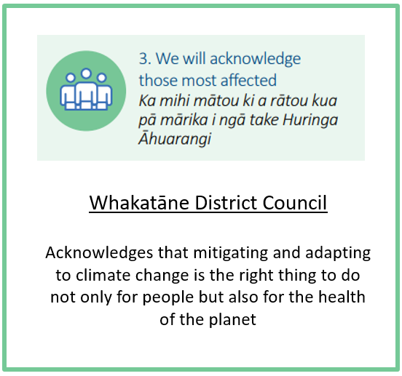
Course structure:
This course is divided into four distinctive modules for easier learning:
Module 1: Climate Change 101
Climate Change 101
International context
National context
Implications of climate change in the BOP
The impact of climate change on our wellbeing
The impact of climate change on the biodiversity and ecology
Module 2: The need to act now
The financial cost of not acting now
The legal cost of not acting now
Natural hazard risk and building resilience
Equity and justice
Assessing climate change from a culturally appropriate context
Module 3: Our role and responsibilities
The role of Council and Local Government
Council’s climate change project
Work underway by others
Module 4: Tools for our response
Circular economies
The DAPP-model
What’s the deal with Carbon
Throughout the course you will find icons that show you which of Council’s Climate Change Principles each topic is addressing
Each module will be followed by a short survey to reflect on your comfort levels with the concepts covered

Slide 5

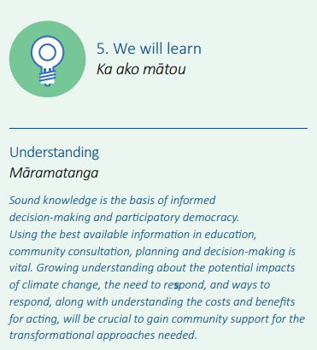



Objectives for this course
We all have a varying level of knowledge and expertise when it comes to climate change.
The main objectives for this course are to:
1. Reach a common level of understanding of issues and concepts relating to climate change.
2. Further realise opportunities to embed Council’s Climate Change Principles across all levels of decision making, BAU and everything we do.
3. To guide discussion when it comes to target setting and the development of Council’s Climate Change Strategy and associated Action Plans this year (2020).

Slide 6
Disclaimer:​
The information included in this e-learning hub has been compiled by the Whakatāne District Council to help us and our community on a journey of learning and development. The Council does not own and is not the authors of most of the content included in this hub. The Council has compiled content that we felt to be relevant, engaging and wherever possible to provide a local context. Further information regarding Council’s Climate Change Principles, our Climate Change project or our current engagement opportunities can we found on our project page:​
https://www.whakatane.govt.nz/climate-change

Slide 7

Let’s get started – jump into Module 1: Climate change 101

