Slide 1
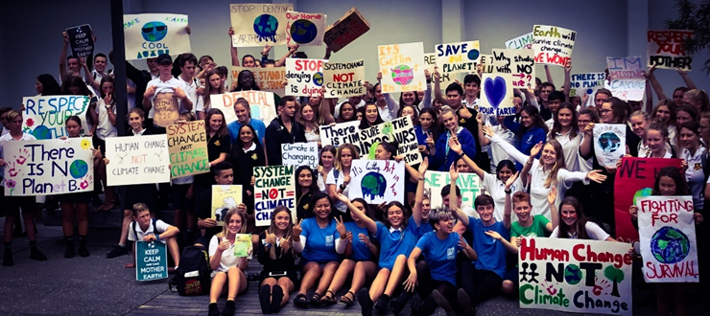
Climate Change – our journey

Slide 2

Mitigation vs Adaptation
Mitigation
Adaptation

Slide 3
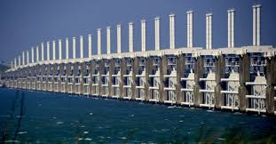
Adaptation

Slide 4
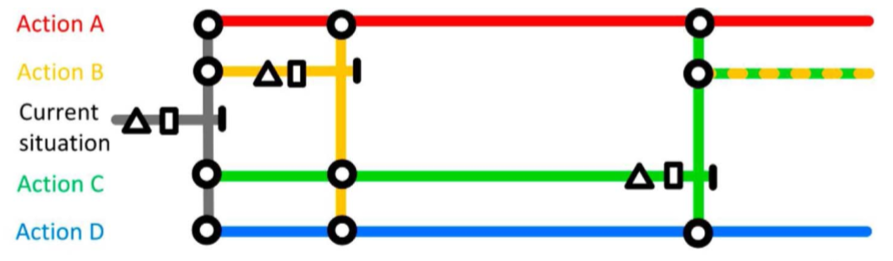
Dynamic Adaptive Pathway Planning

Slide 5
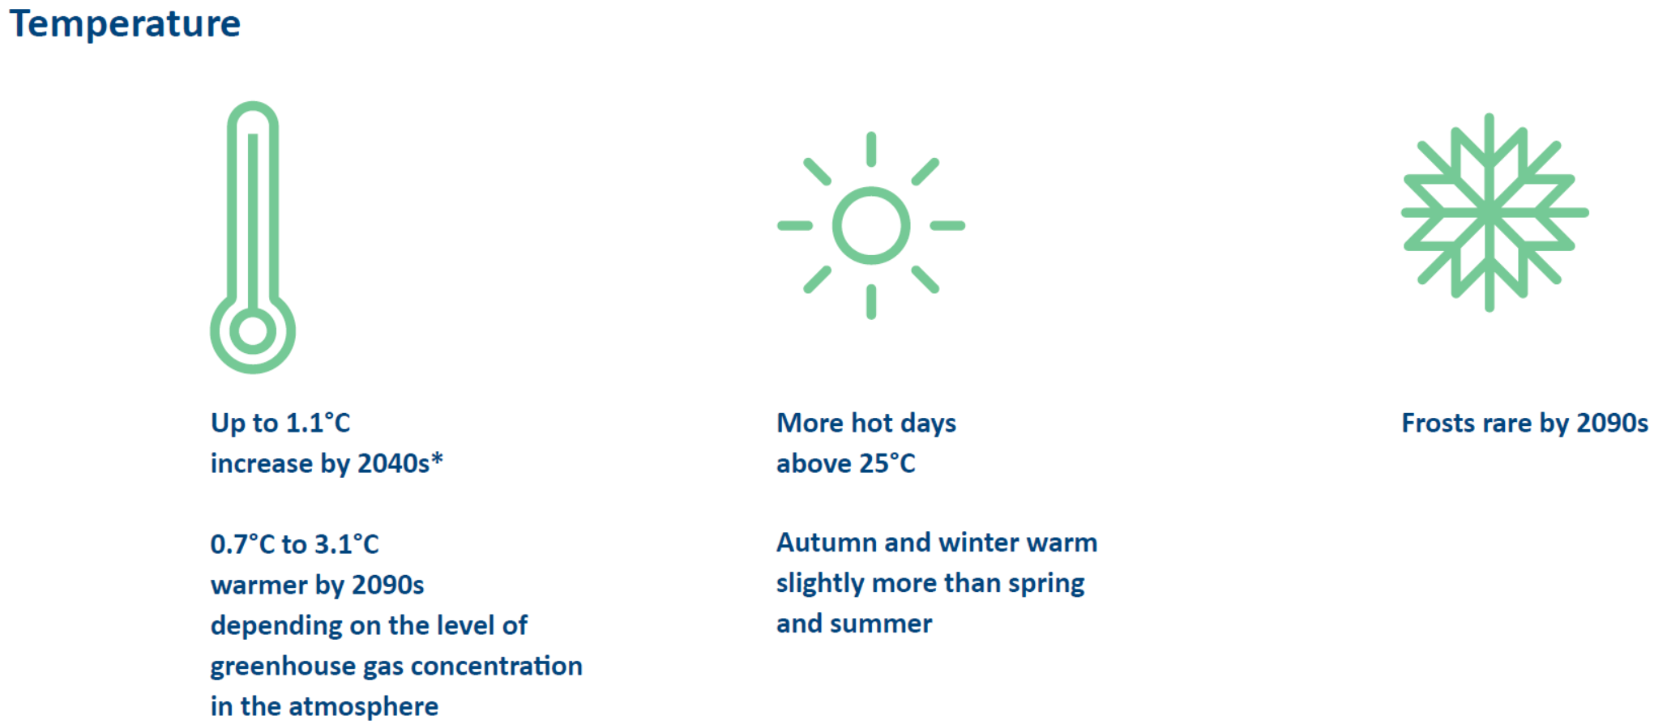
Local Impact

Slide 6
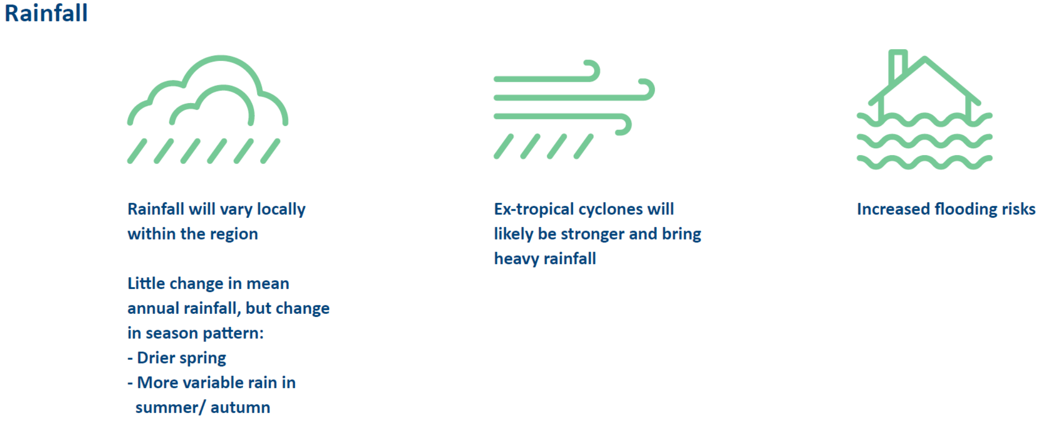
Local Impact

Slide 7
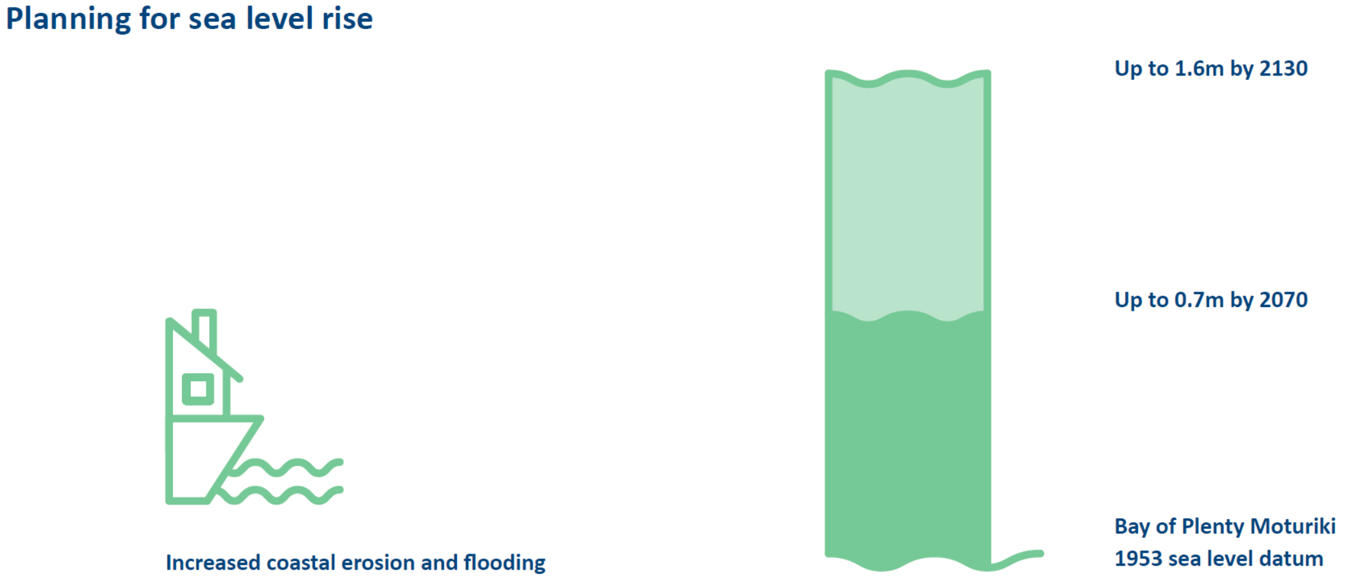
Local Impact

Slide 8

Mitigation

Slide 9

Carbon Emissions
District
Council
1mil tCO2e
3,292 tCO2e

Slide 10
Carbon Footprint – avg/person
District
National
Regional
13.9 tCO2e/person
17.8 tCO2e/person
28.6 tCO2e/person

Slide 11
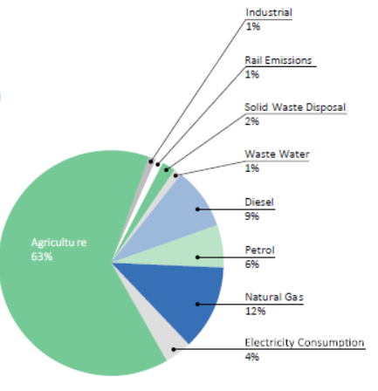
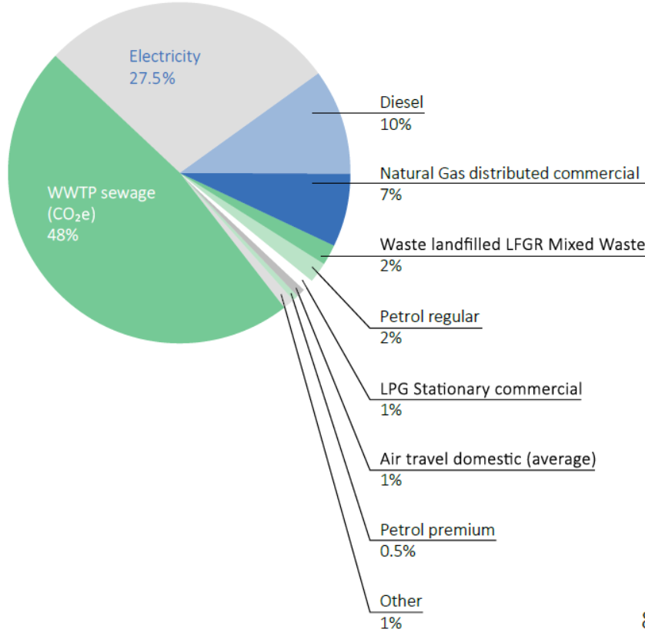
Carbon Emissions
District
Council

Slide 12


Slide 13

7 Climate Change Principles

Slide 14
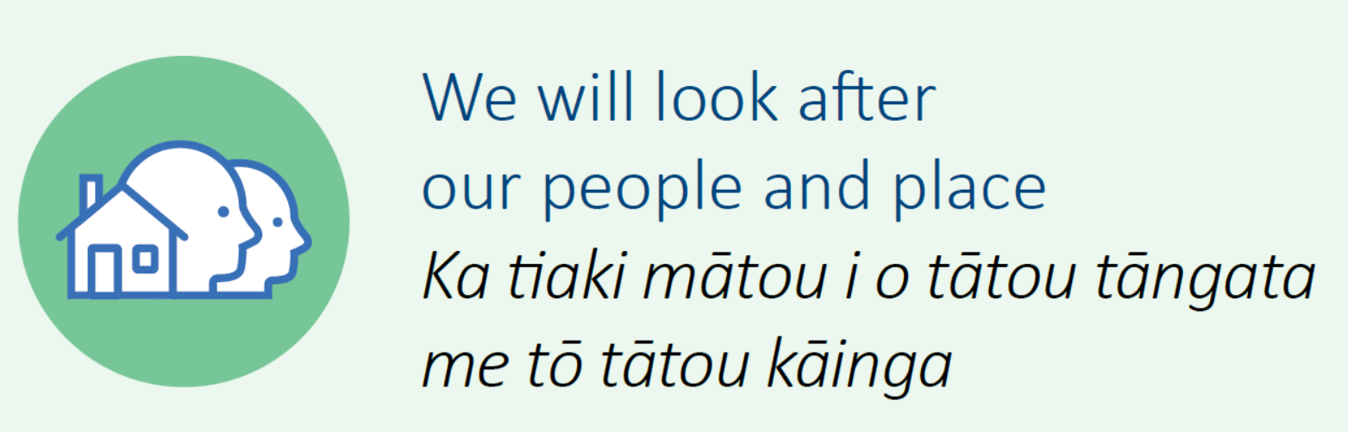
7 Climate Change Principles

Slide 15
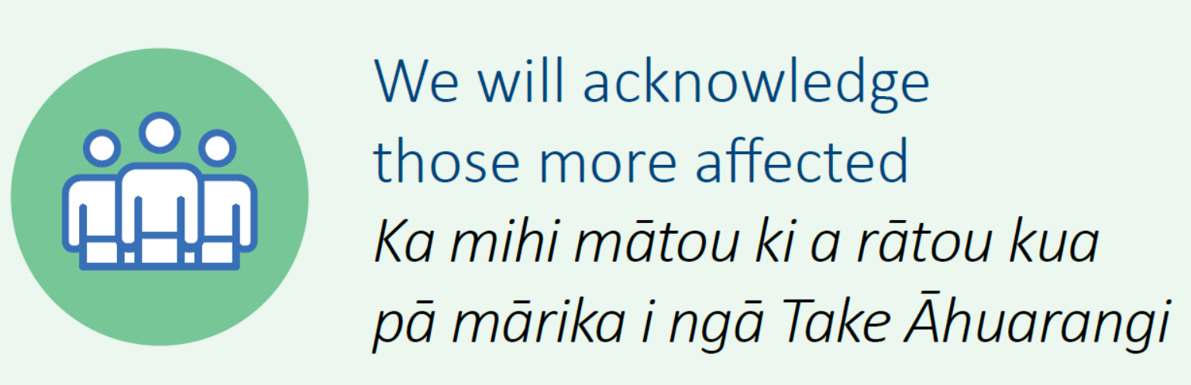
7 Climate Change Principles

Slide 16

7 Climate Change Principles

Slide 17

7 Climate Change Principles

Slide 18
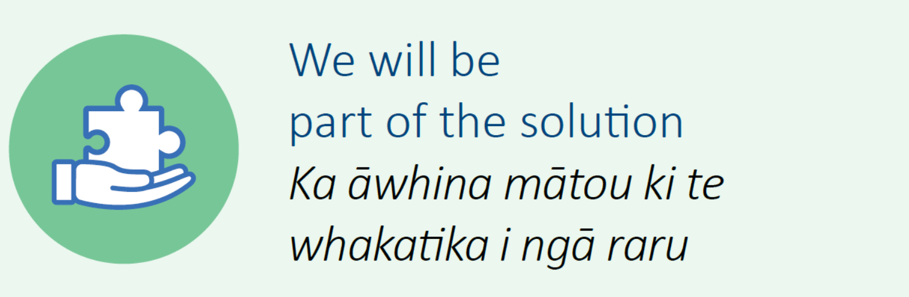
7 Climate Change Principles

Slide 19
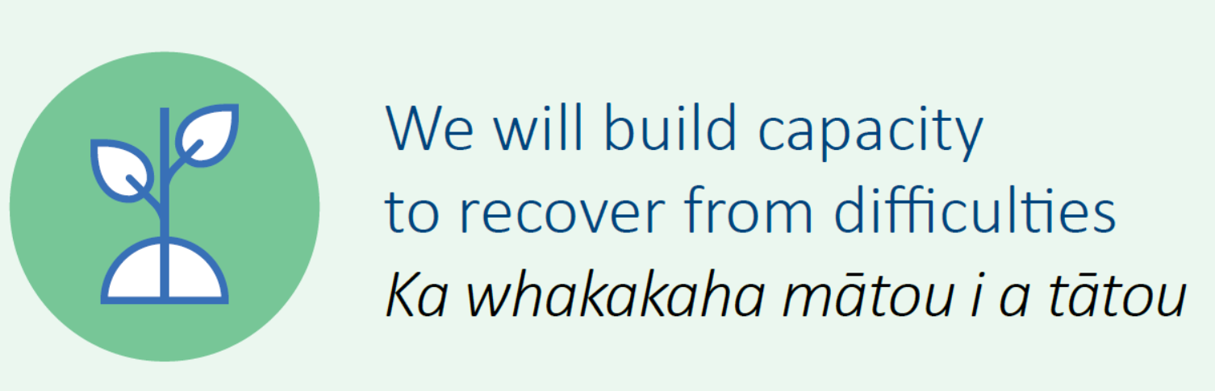
7 Climate Change Principles

Slide 20
What comes next?
Engagement on Principles until 30 August
Council adopt Principles 18 September
Imbed Principles into Council decision-making
Develop a Climate Change Strategy with targets
Develop Action Plans

