Slide 1
Matatā Wastewater Project
Te Niaotanga ō Mataatua ō Te Arawa Co-Design
Infrastructure and Planning Committee
4th September 2025

Slide 2
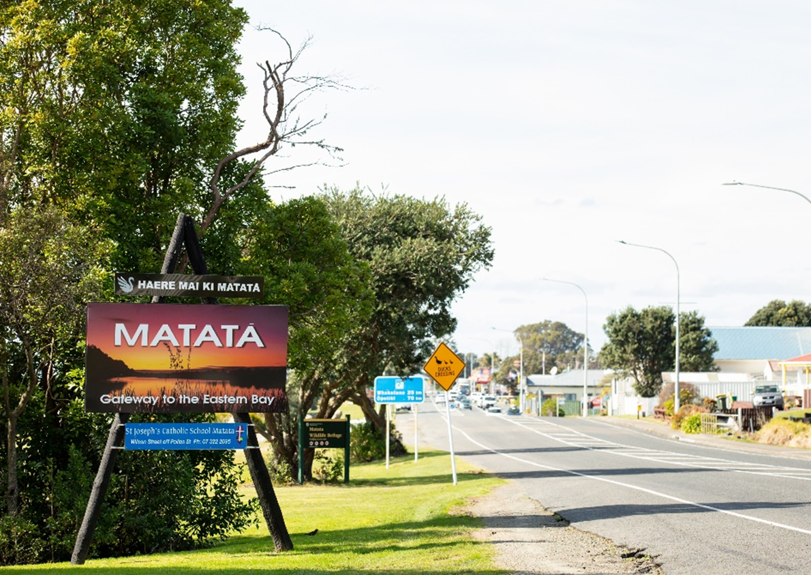
History of the Matatā Area
The coastal township of Matatā lies nestled under the ranges of Whakapaukōrero and slopes in the direction of Te Awa o Te Atua.
The vast wetland that borders and surrounds Te Awa o te Atua has traditionally served as a habitat for many species, including kotuku, inanga and tuna.
The Waitepuru, Waimea and Te Awatarariki are perennial streams that emerge from the hills, run from the township’s relatively high water table. A rich tapestry of important culturally significant sites and wāhi tapu adorns Matatā’s larger environment.
Ngāti Rangitihi, Tūwharetoa ki Kawerau and Ngāti Awa, the tangata whenua of this rohe, have an obligation inherited from their tupuna to protect, maintain, and/ or restore these sites of cultural importance to ensure that present and future activities, of any kind, do not negatively affect the mauri and mana of these important areas.

Slide 3
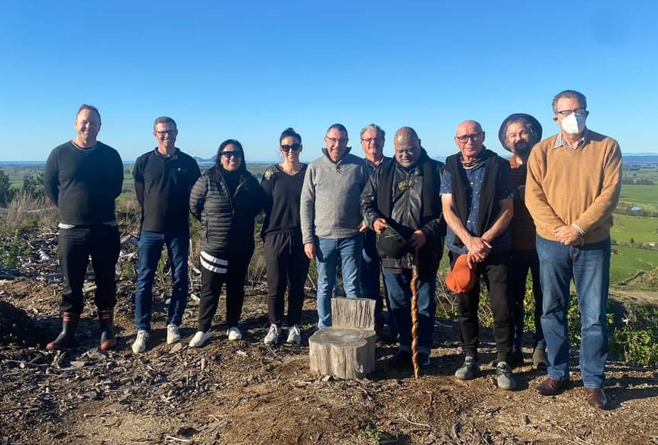
Te Niaotanga ō Mataatua ō Te Arawa Co-design Group
Co-design entails designing with the people of Matatā rather than for them.
Te Niaotanga ō Mataatua ō Te Arawa is made up of representatives from:
Ngāti Rangatihi
Ngāti Awa hapū (Ngai Te Rangihouhiri; Ngati Hikakino and Te Tawera)
Tuwharetoa ki Kawerau
Three Council representatives including two Councillors
Representatives of Te Niaotanga ō Mataatua ō Te Arawa Co-design Group, plus technical team

Slide 4
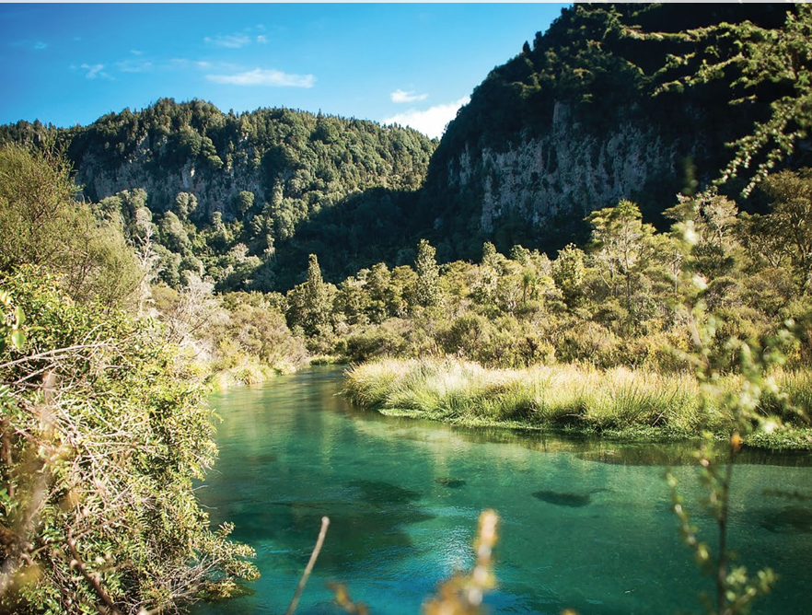
Tarawera Awa Restoration Strategy
The restoration of the Mauri of Tarawera Awa ki Te Awa o Te Atua is at the heart of Ngāti Rangitihi’s 2022 Te Tiriti o Waitangi settlement with the Crown.
The Tarawera Awa Restoration Strategy Group (TARSG) exists to support, co-ordinate and promote the integrated restoration of the mauri of the Tarawera awa catchment.
Ngāti Rangitihi, Ngāti Mākino, Ngāti Awa and Tūwharetoa ki Kawerau take seriously the promise and commitment to the Tarawera awa and Te Awa o Te Atua reflected in Te Tiriti o Waitangi.
TARSG supports the need to find an enduring solution to the wastewater issues in Matata, and the co-design approach used to identify it.
Source: Tarawera Awa Aspirations Document (TARSG)

Slide 5
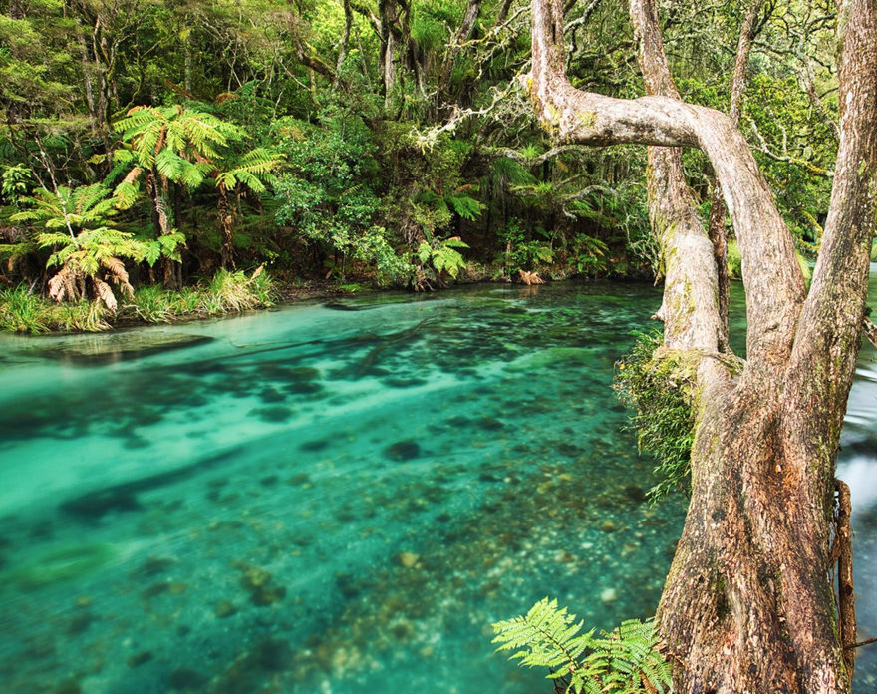
Tarawera Awa Restoration Strategy – Core themes
The strategy focuses on three core themes that inform a series of strategic objectives:
Resilient Taiao — restoring healthy water flows and biodiversity and embedding mātauranga Māori alongside conventional science in decision-making.
Strong Relationships — honouring cultural connection, fostering collective purpose, and deepening relationships with the awa.
Thriving Ecosystems and Communities — supporting sustainable kai gathering, clean and safe waterways, vibrant local economies, and recognition of the awa as a valued visitor destination – for all.
Source: Tarawera Awa Aspirations Document (TARSG)

Slide 6
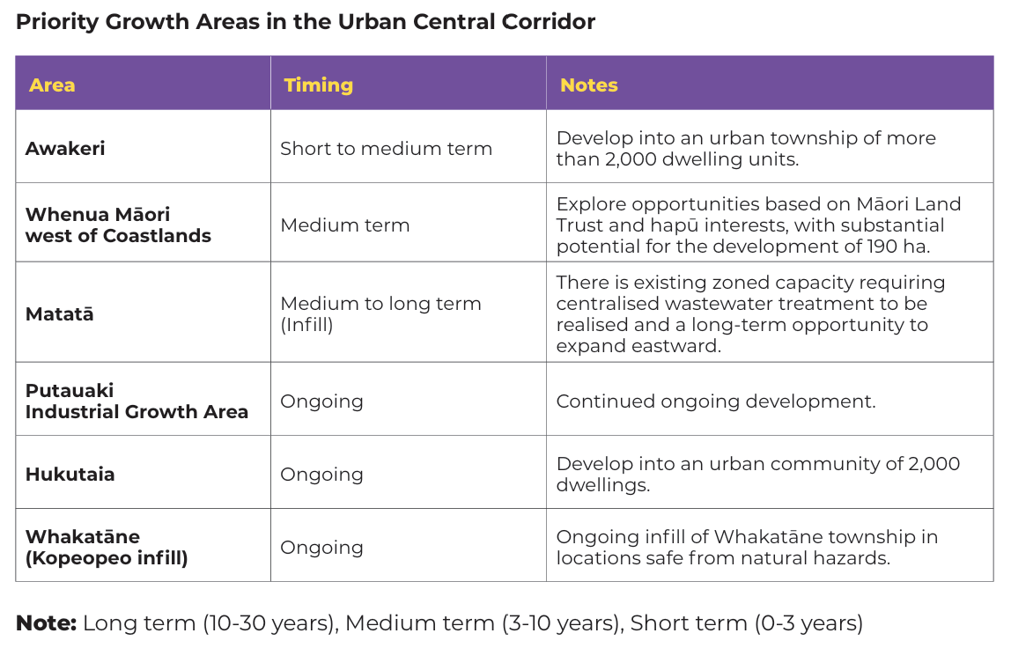
Eastern Bay of Plenty Spatial Plan
Matatā is identified as a ‘Priority Growth Area’ in the Spatial Plan.
Residential zone in the District Plan for Matatā is larger than the current developed urban footprint.
Subject to the development of a reticulated wastewater system, the town is anticipated to grow from approx. 260 to 600–700 homes.
Growth is expected to happen through a mix of infill and subdivision of existing residential properties over the long term of 10 to 30 years.

Slide 7
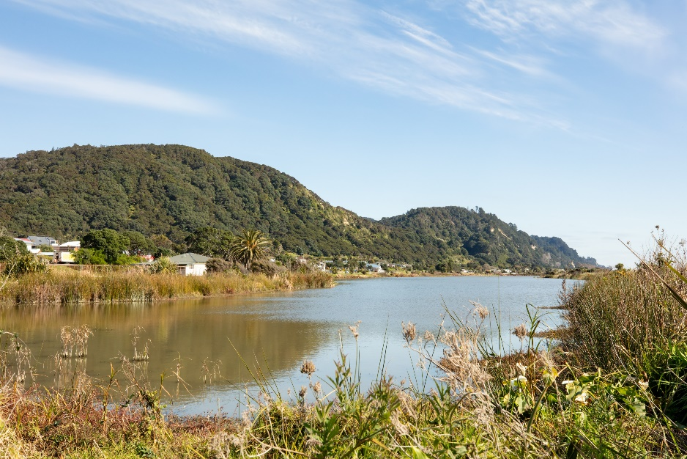
Matatā Wastewater Project outcomes
The Matatā Wastewater Project has been guided by the following overarching outcomes and principles:
Environmental wellbeing and public health outcomes.
Cultural outcomes and consistency with Te Ao Māori principles.
Supporting Whakatane District’s and Mana Whenua growth aspirations.
Right size and futureproof infrastructure for the long-term.
Sustainable and resilient approach, through affordability principles.
Matatā Lagoon

Slide 8
Option 1: Maintenance Zone
If reticulation is not implemented, Matatā would be re-zoned as a Maintenance Zone under the BOPRC OSET Plan.
A Maintenance Zone requires:
  Regular inspections and pump-out of all septic tanks.
  Ongoing compliance monitoring to ensure environmental standards are met.
If maintenance alone does not achieve required improvements, property owners would likely be required to:
  Upgrade to aerated wastewater treatment systems (advanced on-site systems).
  Install compliant land application areas sized between 336–560 m² per dwelling (based on typical flows and soil type).
  Maintain minimum setbacks:
    ≥20 m from any drinking water bore.
    ≥20 m from surface water.
Due to small lot sizes, many sections do not have sufficient space for compliant disposal areas.
This means upgrading to aerated systems is not a viable long-term solution for many properties.
As a result, the Maintenance Zone option is considered high risk and unlikely to meet regulatory requirements over the medium to long term.

Slide 9
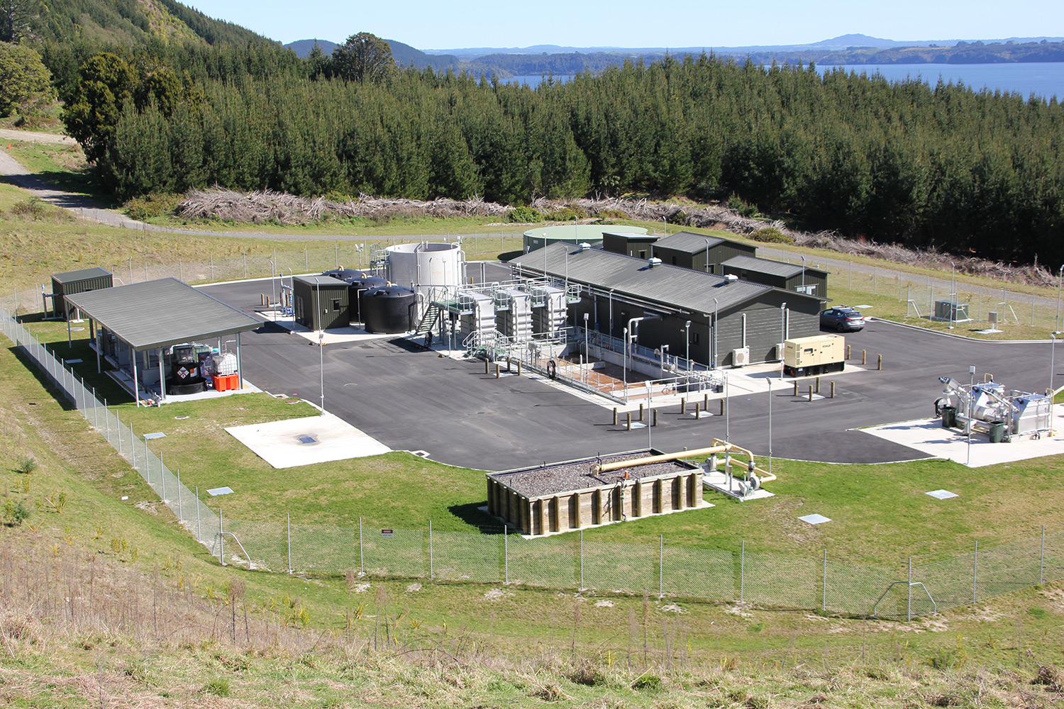
Option 2: Large / Advanced scale
Wastewater is treated centrally via a multiple stage, complex, biological treatment plant.
Sludge requires further treatment/disposal.
Liquid effluent is suitable for land-based disposal methods.
The option includes:
Reticulation: Pressurised system
Household Collection: STEP system
Treatment: Activated sludge and disinfection
Disposal: Low-rate land disposal
This option also requires purchase of additional land for disposal in the long term for a high growth scenario.
Rotoiti / Rotomā WWTP (Rotorua Lakes Council)

Slide 10
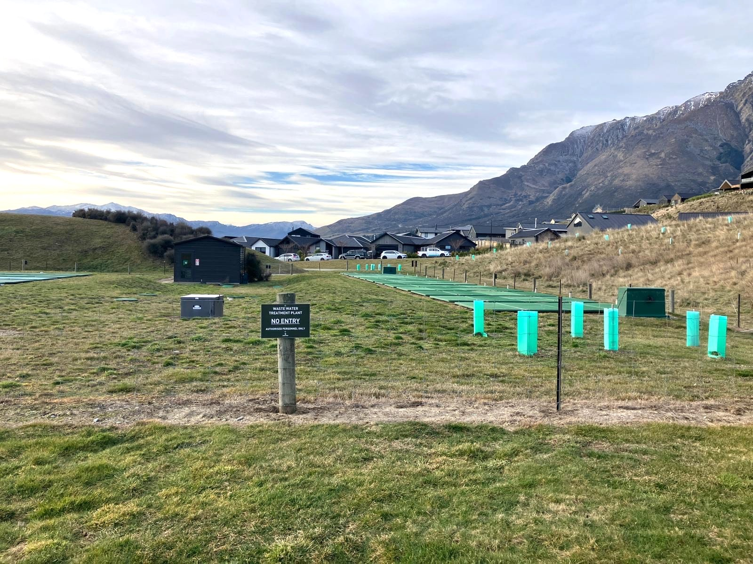
Option 3: Moderate / Intermediate scale
Wastewater is treated centrally via a medium technology, modular treatment plant.
Low sludge.
Liquid effluent is suitable for land-based disposal methods.
This option includes:
Reticulation: Pressurised system
Household Collection: STEP system
Treatment: Packed bed bioreactor
Disposal: Low-rate irrigation
Includes drainage and recontouring of Tahi Hill Farm to maximise area available for land application (including up to 700 homes), avoiding need for additional land.
Jacks Point, Queenstown
Unchanged
Unchanged

Slide 11
Next steps
The project technical workstreams for options analysis are complete.
Next steps would include development of a consenting strategy on the preferred option (if approved by Council). This would include the following:
Workstream | Next Steps
Costing and Funding | Undertake further detailed costing on the preferred option. Work with elected members on the different tools and levers that could be used to fund and finance the project to ensure delivery and affordability principles are appropriate.
Cultural Narrative | Develop archaeological report (underway) and Cultural Impact Assessment for Tahi Hill Farm.
Wastewater System Analysis | Determine treated effluent quality requirements for irrigation to Tahi Hill Farm.
Land Analysis | Determine land requirements to support both treatment and irrigation including future drainage and/or earthworks.
Environment Monitoring | Complete Assessment of Environmental Effects (AEE) for Tahi Hill Farm and overall project.
Resource consent | Develop consenting strategy. Engage Stakeholder Liaison role to support community engagement.
Business case | Update business case to include additional information on options analysis and preferred option. Seek funding support including from MoH subsidy and key partners.

